Slide 1
Latent Variables & Embeddings
3
Turning Anything into Meaningful Vectors
PCA • Correspondence Analysis • Multidimensional Scaling • Autoencoders

Slide 2
Course Roadmap
Four classical-to-modern techniques, one unifying goal: represent complex data as low-dimensional vectors that preserve the structure that matters.
1
Principal Component Analysis
2
Correspondence Analysis
Linear projection maximizing variance
PCA for categorical / contingency data
3
Multidimensional Scaling
4
Autoencoders
Embedding from distances alone
Nonlinear neural compression & embeddings

Slide 3
Principal Component Analysis
Linear projection that maximizes variance
INTUITION
HOW TO USE
Find new axes — the principal components — that point in the directions of greatest variance in the data. The first captures the most spread; each next captures the most that remains while staying perpendicular to the others. Keeping the top few axes preserves the dominant structure and discards noise.
• Center and standardize the features
• Compute the covariance matrix, then its eigenvectors (or use SVD)
• Rank components by explained variance (scree plot)
• Keep the top-k and project the data onto them
• Use for: visualization, denoising, preprocessing

Slide 4
Correspondence Analysis
PCA's cousin for categorical / contingency data
INTUITION
HOW TO USE
Take a contingency table — counts of how categories co-occur — and measure how far it strays from independence (chi-square distances). CA places both the rows and the columns in one shared low-dimensional space, so categories that tend to occur together land near each other and associations become visible at a glance.
• Start from a contingency table of category counts
• Convert counts to row and column profiles (relative frequencies)
• Decompose the standardized residuals via SVD
• Plot rows and columns together on the first 2 axes (biplot)
• Read nearby points as associated; check inertia per axis

Slide 5
Multidimensional Scaling
Build an embedding from distances alone
INTUITION
HOW TO USE
Suppose you only know the pairwise distances between objects, not their coordinates. MDS searches for positions in a low-dimensional space so that the distances between the placed points match the given dissimilarities as closely as possible — in effect turning a distance matrix back into a map you can plot.
• Assemble a pairwise distance / dissimilarity matrix
• Choose classical (metric) or non-metric MDS
• Metric: eigendecompose the double-centered matrix
• Non-metric: preserve rank order, minimize stress
• Embed in 2–3D; judge fit with stress / Shepard plot

Slide 6
Autoencoders
Nonlinear neural compression & embeddings
INTUITION
HOW TO USE
A neural network trained to reproduce its own input through a narrow bottleneck. The encoder squeezes the input into a small latent code; the decoder rebuilds the input from it. To reconstruct well through so few numbers, the network is forced to learn a compact, nonlinear representation of the structure that matters.
• Define encoder → bottleneck → decoder layers
• Train to minimize reconstruction loss (e.g. MSE) on unlabeled data
• Use the bottleneck activations as learned embeddings
• Variants: denoising, sparse, variational (VAE)
• Use for nonlinear reduction, anomaly detection, generation

Slide 7
Turning Anything into Meaningful Vectors
Text, images, users, products, documents, genes — almost any object can be encoded as a point in a vector space. Once data lives in ℝᵈ, geometry does the work: similarity becomes distance, structure becomes shape, and learning becomes optimization.
Raw object
Encoding
Vector x ∈ ℝᵈ
Embedding z ∈ ℝᵏ
Text, image, table row, graph node
Counts, pixels, features, similarities
Coordinates in a space
Compressed, meaningful (k ≪ d)

Slide 8
Why This Toolkit Enables Advanced Visualization
Once objects become vectors, dimensionality reduction and clustering reveal structure that is invisible in raw high-dimensional data.
1
Data Reduction
2
Nonlinearity
PCA, CA and MDS collapse dozens or thousands of dimensions into 2–3, so an entire dataset fits on one screen while keeping its dominant structure.
Autoencoders and distance-based methods unfold curved manifolds that flat linear projections distort — exposing structure PCA alone would miss.
3
Clustering = Segments
4
Patterns & Outliers
Cluster in the reduced space, then color the embedding by cluster: geometry becomes named groups you can interpret, compare and label.
In the embedding, similarity becomes proximity — neighborhoods, gradients and anomalies become visible to the eye, guiding analysis and QA.
Reduce → embed → cluster → visualize: the pipeline behind modern exploratory data analysis.

Slide 9


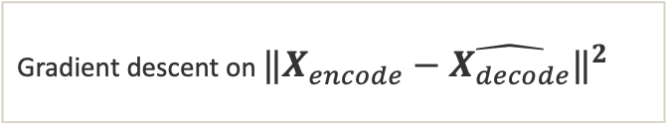
The Common Thread
All four methods solve one problem: find a low-dimensional representation Z ∈ ℝⁿˣᵏ of data X ∈ ℝⁿˣᵖ that preserves a chosen notion of structure.
Method
Preserves
Map
Core operation
PCA
Variance / covariance
Linear
Eigen-decomposition of $X^{T}X$
Correspondence Analysis
χ² association in tables
Linear
SVD of standardized residuals
MDS
Pairwise distances
Linear (classical)
Eigen-decomp of $−\frac{1}{2}JD^{(2)}J$
Autoencoders
Reconstruction error
Nonlinear
Gradient descent on $‖X_{encode}−\hat{X_{decode}}‖^{2}$

Slide 10
01
Principal Component Analysis
Linear projection that maximizes retained variance

Slide 11
PCA — The Core Idea
PCA finds a new orthogonal coordinate system for the data in which the first axis captures the most variance, the second captures the most of what remains, and so on.
Three equivalent views
Why we do it
• Variance view: directions of maximum spread in the cloud of points.
• Reconstruction view: the k-dim subspace minimizing squared projection error (best-fitting hyperplane).
• Decorrelation view: a rotation that makes the new coordinates mutually uncorrelated.
All three give the same answer: the eigenvectors of the covariance matrix, ordered by eigenvalue.
Compression
Keep $k≪p$ coordinates
De-noising
Drop low-variance directions
Visualization
Plot on PC1–PC2
Decorrelation
Inputs for downstream models

Slide 12





Eigenvectors & Eigenvalues — The Intuition
Applying a matrix usually rotates a vector. A few special vectors keep their direction — they only get scaled. Those are the eigenvectors.
$$A v = λ v$$
$$λv$$
• v — the eigenvector: its direction is preserved
• λ — the eigenvalue: the factor v is stretched by
• Most vectors change direction; eigenvectors do not
$$Aw$$
$$v$$
$$w$$
same line → eigenvector

Slide 13




What the Eigenvalue Tells You
λ is the signed scale factor along an eigenvector — it stretches, shrinks, flips, or leaves the vector unchanged. (Grey = original v, purple = Av.)
$$λ > 1$$
$$0 < λ < 1$$
$$λ < 0$$
$$λ = 1$$
Stretch
Shrink
Flip & scale
Unchanged

Slide 14
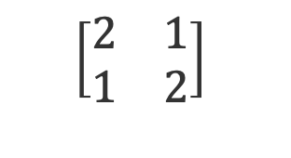



Example 1 (2×2) — Step 1: The Setup
Step 1 / 5
Goal: find the vectors that A only scales — solve A v = λ v.
$$\left[\begin{matrix}2 & 1 \\ 1 & 2\end{matrix}\right]$$
$$A v = λ v$$
$$A =$$
$$(A − λI) v = 0$$
Av
A nonzero v can exist only when det( A − λI ) = 0 — the characteristic equation.
v
Most v: Av leaves v's direction

Slide 15
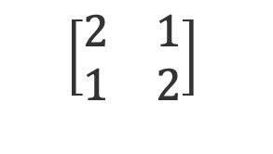
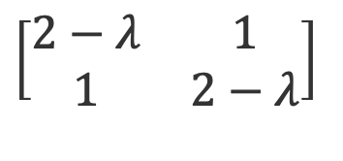


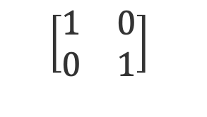

Example 1 (2×2) — Step 2: Form A − λI
Step 2 / 5
Subtract λ from the diagonal. A nonzero v exists only if this matrix is singular.
det A = 3
$$\left[\begin{matrix}2 & 1 \\ 1 & 2\end{matrix}\right]$$
$$\left[\begin{matrix}1 & 0 \\ 0 & 1\end{matrix}\right]$$
$$A − λI =$$
$$− λ$$
$$\left[\begin{matrix}2−λ & 1 \\ 1 & 2−λ\end{matrix}\right]$$
$$=$$
1
Set det( A − λI ) = 0 to find the λ that make it singular.
det = 0
det = area scale — a zero det flattens it to a line

Slide 16

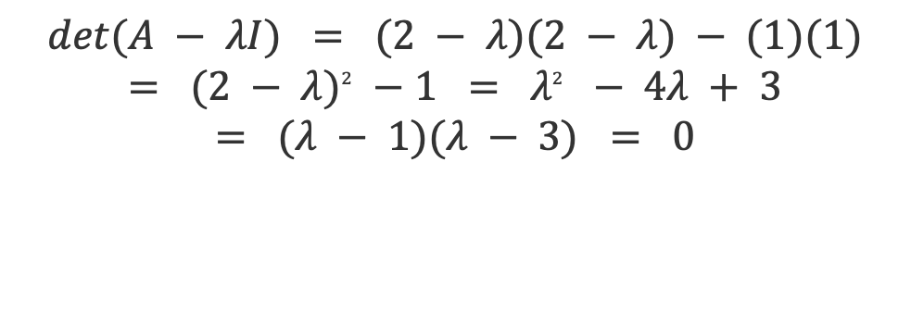
Example 1 (2×2) — Step 3: Solve det = 0
Step 3 / 5
Expand the 2×2 determinant into a quadratic in λ and factor it.
$$det(A − λI) = (2 − λ)(2 − λ) − (1)(1)$$
$$= {(2 − λ)}^{2} − 1 = λ^{2} − 4λ + 3$$
$$= (λ − 1)(λ − 3) = 0$$
p(λ) = λ² − 4λ + 3
λ = 1
λ = 3
$$λ_{1} = 3 λ_{2} = 1$$
Where the curve crosses zero, A − λI is singular

Slide 17
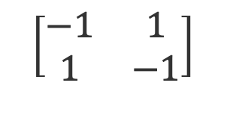


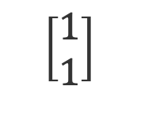
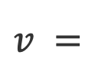
Example 1 (2×2) — Step 4: Eigenvector for λ = 3
Step 4 / 5
Plug λ = 3 into (A − λI)v = 0 and solve the resulting system.
$$\left[\begin{matrix}−1 & 1 \\ 1 & −1\end{matrix}\right]$$
Av = 3v
$$A − 3I =$$
$$(A − 3I) v = 0 ⇒ −x + y = 0 ⇒ y = x$$
$$\left[\begin{matrix}1 \\ 1\end{matrix}\right]$$
v
$$v =$$
$$(λ = 3)$$
On the line y = x, A only stretches — by 3

Slide 18
Where the row equations come from (λ = 3)
Aside
(A − 3I)v = 0 is two equations in disguise — one for each row of the matrix.
Multiply A − 3I by v = (x, y), one row at a time. Each row becomes one plain equation:
Row 1: (−1)x + (1)y = 0 ⇒ −x + y = 0 ⇒ y = x
Row 2: (1)x + (−1)y = 0 ⇒ x − y = 0 ⇒ the same equation
Row 2 is just Row 1 multiplied by −1, so it adds nothing. Having only one independent equation for two unknowns is exactly what det(A − 3I) = 0 buys us — and it is why a nonzero v can exist at all.
Choose x = 1 ⇒ v = (1, 1). Any nonzero multiple of v is also an eigenvector.

Slide 19
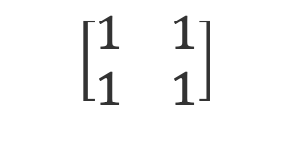
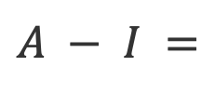
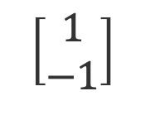
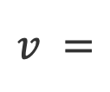
Example 1 (2×2) — Step 5: Eigenvector for λ = 1
Step 5 / 5
Repeat with λ = 1, then collect both eigenpairs.
$$\left[\begin{matrix}1 & 1 \\ 1 & 1\end{matrix}\right]$$
$$A − I =$$
λ = 3 × 3
$$(A − I) v = 0 ⇒ x + y = 0 ⇒ y = −x$$
$$\left[\begin{matrix}1 \\ −1\end{matrix}\right]$$
$$v =$$
λ = 1 × 1
$$Eigenpairs: λ = 3 → \left[\begin{matrix}1 & 1\end{matrix}\right] λ = 1 → \left[\begin{matrix}1 & −1\end{matrix}\right]$$
y = x stretches by 3; y = −x is unchanged

Slide 20
Where the row equations come from (λ = 1)
Aside
(A − I)v = 0 is two equations in disguise — one for each row of the matrix.
Multiply A − I by v = (x, y), one row at a time. Each row becomes one plain equation:
Row 1: (1)x + (1)y = 0 ⇒ x + y = 0 ⇒ y = −x
Row 2: (1)x + (1)y = 0 ⇒ x + y = 0 ⇒ the same equation
Row 2 is identical to Row 1, so it adds nothing. Having only one independent equation for two unknowns is exactly what det(A − I) = 0 buys us — and it is why a nonzero v can exist at all.
Choose x = 1 ⇒ v = (1, −1). Any nonzero multiple of v is also an eigenvector.

Slide 21
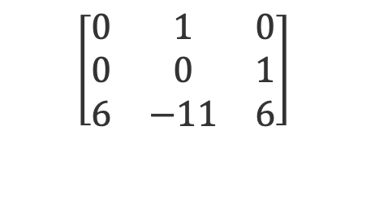



Example 2 (3×3) — Step 1: The Setup
Step 1 / 7
Same recipe in 3-D: solve A v = λ v through det(A − λI) = 0. (A is a companion matrix.)
$$\left[\begin{matrix}0 & 1 & 0 \\ 0 & 0 & 1 \\ 6 & −11 & 6\end{matrix}\right]$$
$$A v = λ v$$
$$A =$$
$$(A − λI) v = 0$$
det( A − λI ) = 0 now expands into a cubic — it will have three eigenvalues.

Slide 22
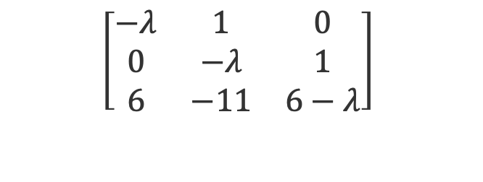

Example 2 (3×3) — Step 2: Form A − λI
Step 2 / 7
Subtract λ from each diagonal entry.
$$\left[\begin{matrix}−λ & 1 & 0 \\ 0 & −λ & 1 \\ 6 & −11 & 6−λ\end{matrix}\right]$$
$$A − λI =$$
Next: expand this determinant by cofactors down the first column.

Slide 23
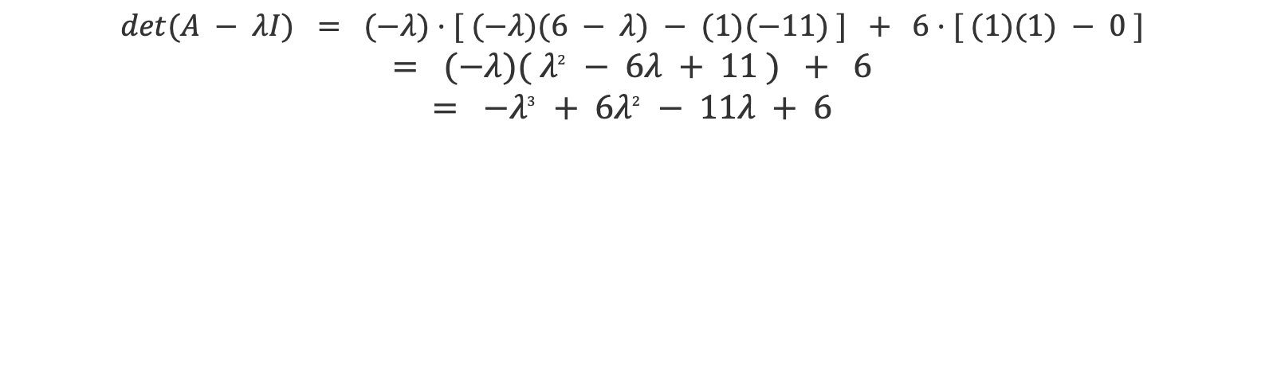
Example 2 (3×3) — Step 3: Expand the Determinant
Step 3 / 7
Cofactor expansion down column 1; the middle entry is 0, so it drops out.
$$det(A − λI) = (−λ)·[ (−λ)(6 − λ) − (1)(−11) ] + 6·[ (1)(1) − 0 ]$$
$$= (−λ)( λ^{2} − 6λ + 11 ) + 6$$
$$= −λ^{3} + 6λ^{2} − 11λ + 6$$

Slide 24
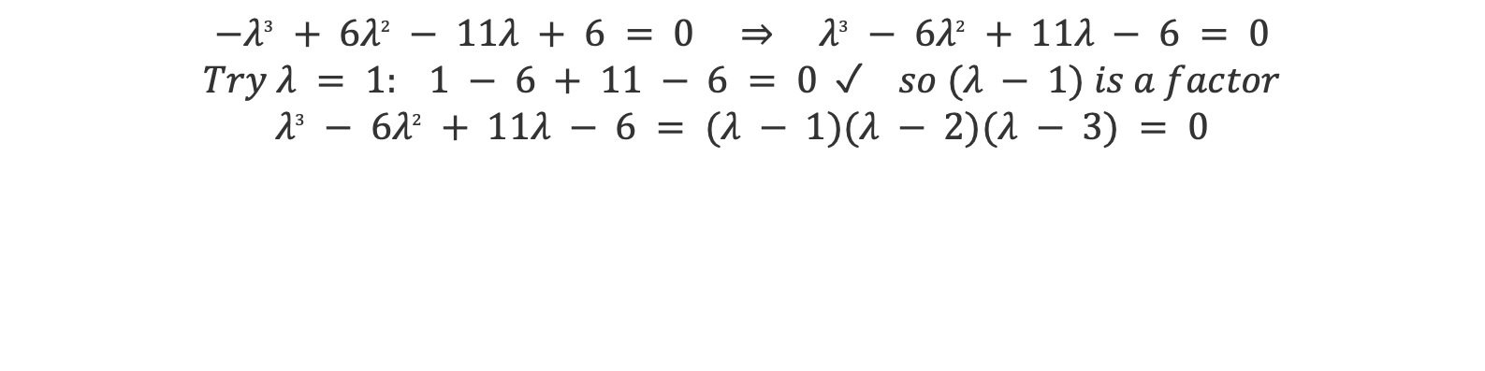
Example 2 (3×3) — Step 4: Solve the Cubic
Step 4 / 7
Find one integer root, then factor the cubic completely.
$$−λ^{3} + 6λ^{2} − 11λ + 6 = 0 ⇒ λ^{3} − 6λ^{2} + 11λ − 6 = 0$$
$$Try λ = 1: 1 − 6 + 11 − 6 = 0 ✓ so (λ − 1) is a factor$$
$$λ^{3} − 6λ^{2} + 11λ − 6 = (λ − 1)(λ − 2)(λ − 3) = 0$$
$$λ_{1} = 1 λ_{2} = 2 λ_{3} = 3$$

Slide 25
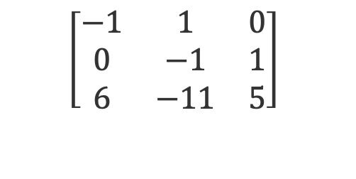


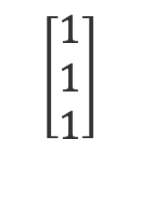
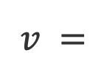
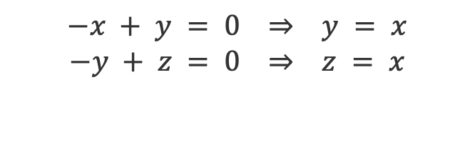
Example 2 (3×3) — Step 5: Eigenvector for λ = 1
Step 5 / 7
Solve (A − I)v = 0; the first two rows give a chain of substitutions.
$$\left[\begin{matrix}−1 & 1 & 0 \\ 0 & −1 & 1 \\ 6 & −11 & 5\end{matrix}\right]$$
$$−x + y = 0 ⇒ y = x$$
$$−y + z = 0 ⇒ z = x$$
$$A − I =$$
$$\left[\begin{matrix}1 \\ 1 \\ 1\end{matrix}\right]$$
$$v =$$
$$(λ = 1)$$

Slide 26
Where the row equations come from (λ = 1)
Aside
(A − I)v = 0 is three equations in disguise — one for each row of the matrix.
Multiply A − I by v = (x, y, z), one row at a time. Each row becomes one plain equation:
Row 1: (−1)x + (1)y + (0)z = 0 ⇒ −x + y = 0 ⇒ y = x
Row 2: (0)x + (−1)y + (1)z = 0 ⇒ −y + z = 0 ⇒ z = y = x
Row 3: (6)x + (−11)y + (5)z = 0 ⇒ 6x − 11x + 5x = 0 ⇒ 0 = 0
Row 3 tells us nothing new — it is automatically satisfied. That redundancy is exactly what det(A − I) = 0 buys us, and it is why a nonzero v can exist at all.
Choose x = 1 ⇒ v = (1, 1, 1). Any nonzero multiple of v is also an eigenvector.

Slide 27
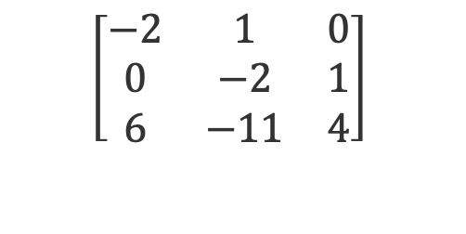


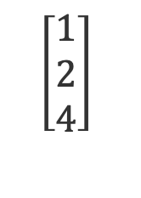
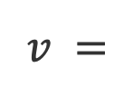
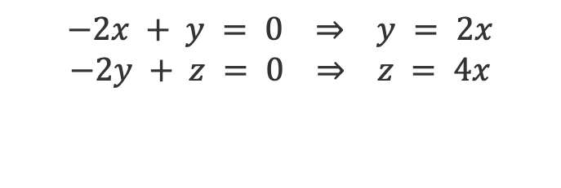
Example 2 (3×3) — Step 6: Eigenvector for λ = 2
Step 6 / 7
Same substitution chain with λ = 2.
$$\left[\begin{matrix}−2 & 1 & 0 \\ 0 & −2 & 1 \\ 6 & −11 & 4\end{matrix}\right]$$
$$−2x + y = 0 ⇒ y = 2x$$
$$−2y + z = 0 ⇒ z = 4x$$
$$A − 2I =$$
$$\left[\begin{matrix}1 \\ 2 \\ 4\end{matrix}\right]$$
$$v =$$
$$(λ = 2)$$

Slide 28
Where the row equations come from (λ = 2)
Aside
(A − 2I)v = 0 is three equations in disguise — one for each row of the matrix.
Multiply A − 2I by v = (x, y, z), one row at a time. Each row becomes one plain equation:
Row 1: (−2)x + (1)y + (0)z = 0 ⇒ −2x + y = 0 ⇒ y = 2x
Row 2: (0)x + (−2)y + (1)z = 0 ⇒ −2y + z = 0 ⇒ z = 2y = 4x
Row 3: (6)x + (−11)y + (4)z = 0 ⇒ 6x − 22x + 16x = 0 ⇒ 0 = 0
Row 3 tells us nothing new — it is automatically satisfied. That redundancy is exactly what det(A − 2I) = 0 buys us, and it is why a nonzero v can exist at all.
Choose x = 1 ⇒ v = (1, 2, 4). Any nonzero multiple of v is also an eigenvector.

Slide 29
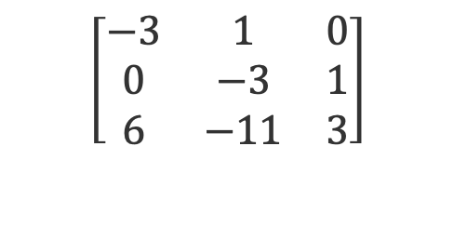

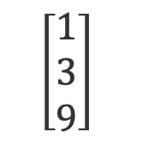
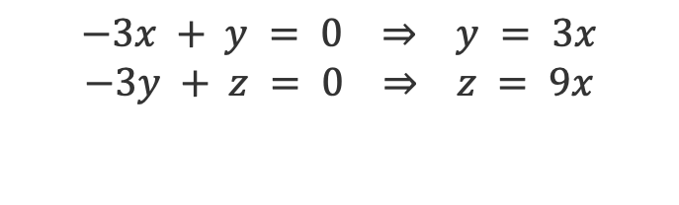
Example 2 (3×3) — Step 7: Eigenvector for λ = 3
Step 7 / 7
Last one, then collect all three eigenpairs.
$$\left[\begin{matrix}−3 & 1 & 0 \\ 0 & −3 & 1 \\ 6 & −11 & 3\end{matrix}\right]$$
$$−3x + y = 0 ⇒ y = 3x$$
$$−3y + z = 0 ⇒ z = 9x$$
$$A − 3I =$$
$$\left[\begin{matrix}1 \\ 3 \\ 9\end{matrix}\right]$$
$$v =$$
$$Eigenpairs: λ = 1 → \left[\begin{matrix}1 & 1 & 1\end{matrix}\right] λ = 2 → \left[\begin{matrix}1 & 2 & 4\end{matrix}\right] λ = 3 → \left[\begin{matrix}1 & 3 & 9\end{matrix}\right]$$

Slide 30
Where the row equations come from (λ = 3)
Aside
(A − 3I)v = 0 is three equations in disguise — one for each row of the matrix.
Multiply A − 3I by v = (x, y, z), one row at a time. Each row becomes one plain equation:
Row 1: (−3)x + (1)y + (0)z = 0 ⇒ −3x + y = 0 ⇒ y = 3x
Row 2: (0)x + (−3)y + (1)z = 0 ⇒ −3y + z = 0 ⇒ z = 3y = 9x
Row 3: (6)x + (−11)y + (3)z = 0 ⇒ 6x − 33x + 27x = 0 ⇒ 0 = 0
Row 3 tells us nothing new — it is automatically satisfied. That redundancy is exactly what det(A − 3I) = 0 buys us, and it is why a nonzero v can exist at all.
Choose x = 1 ⇒ v = (1, 3, 9). Any nonzero multiple of v is also an eigenvector.

Slide 31
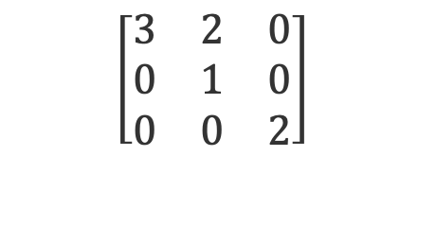

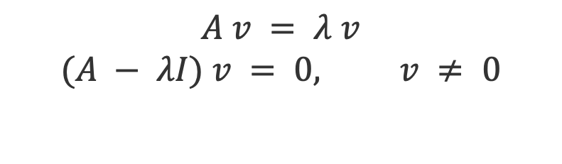
Example 3 (3×3, triangular) — Step 1: The Setup
Step 1 / 7
A third example with an upper-triangular matrix — watch how that shortcuts the determinant.
$$\left[\begin{matrix}3 & 2 & 0 \\ 0 & 1 & 0 \\ 0 & 0 & 2\end{matrix}\right]$$
$$A v = λ v$$
$$(A − λI) v = 0, v ≠ 0$$
$$A =$$
All entries below the diagonal are 0 → the eigenvalues will read straight off the diagonal.

Slide 32
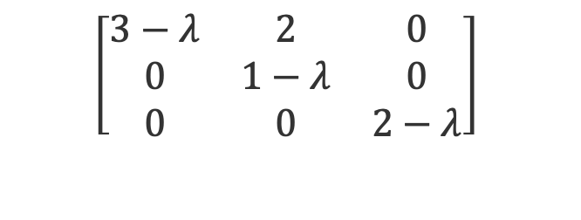
Example 3 (3×3, triangular) — Step 2: Form A − λI
Step 2 / 7
Subtract λ from each diagonal entry — the zeros below the diagonal stay put.
$$\left[\begin{matrix}3−λ & 2 & 0 \\ 0 & 1−λ & 0 \\ 0 & 0 & 2−λ\end{matrix}\right]$$
$$A − λI =$$
Still upper-triangular → det = product of the diagonal entries.

Slide 33
Example 3 (3×3, triangular) — Step 3: The Determinant
Step 3 / 7
No cofactor expansion needed — the triangular shortcut does the work.
For a triangular matrix, the determinant is just the product of the diagonal entries:
$$det(A − λI) = (3 − λ)(1 − λ)(2 − λ)$$
$$Set it to zero: (3 − λ)(1 − λ)(2 − λ) = 0$$
It is already factored — each factor gives one eigenvalue.

Slide 34

Example 3 (3×3, triangular) — Step 4: The Eigenvalues
Step 4 / 7
Each factor set to zero gives one eigenvalue.
$$3 − λ = 0 ⇒ λ = 3$$
$$1 − λ = 0 ⇒ λ = 1$$
$$2 − λ = 0 ⇒ λ = 2$$
$$λ_{1} = 3 λ_{2} = 1 λ_{3} = 2 ( = the diagonal! )$$

Slide 35
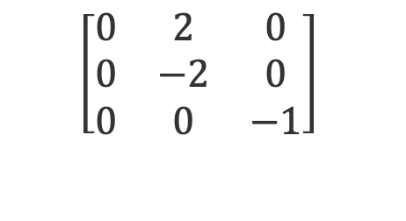


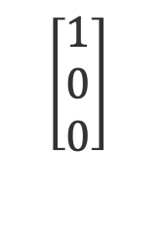
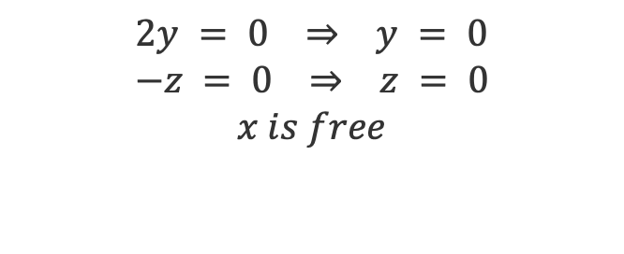
Example 3 (3×3) — Step 5: Eigenvector for λ = 3
Step 5 / 7
Solve (A − 3I)v = 0.
$$\left[\begin{matrix}0 & 2 & 0 \\ 0 & −2 & 0 \\ 0 & 0 & −1\end{matrix}\right]$$
$$2y = 0 ⇒ y = 0$$
$$−z = 0 ⇒ z = 0$$
$$x is free$$
$$A − 3I =$$
$$\left[\begin{matrix}1 \\ 0 \\ 0\end{matrix}\right]$$
$$v =$$
$$(λ = 3)$$

Slide 36
Where the row equations come from (λ = 3)
Aside
(A − 3I)v = 0 is three equations in disguise — one for each row of the matrix.
Multiply A − 3I by v = (x, y, z), one row at a time. Each row becomes one plain equation:
Row 1: (0)x + (2)y + (0)z = 0 ⇒ 2y = 0 ⇒ y = 0
Row 2: (0)x + (−2)y + (0)z = 0 ⇒ −2y = 0 ⇒ y = 0 again
Row 3: (0)x + (0)y + (−1)z = 0 ⇒ −z = 0 ⇒ z = 0
Notice that x never appears — the whole first column is zero, so no row constrains it. That unconstrained direction is the eigenvector.
x is free. Choose x = 1 ⇒ v = (1, 0, 0). Any nonzero multiple of v is also an eigenvector.

Slide 37
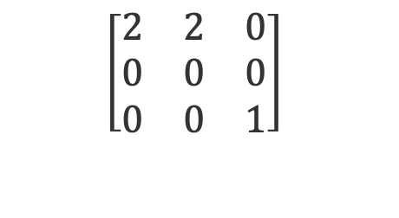

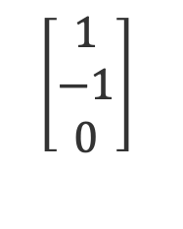
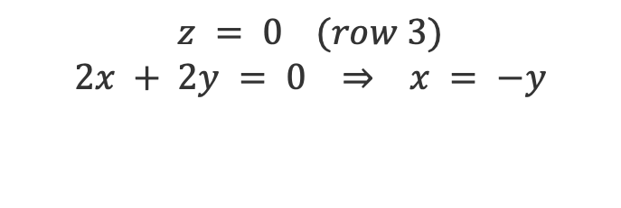
Example 3 (3×3) — Step 6: Eigenvector for λ = 1
Step 6 / 7
Solve (A − I)v = 0.
$$\left[\begin{matrix}2 & 2 & 0 \\ 0 & 0 & 0 \\ 0 & 0 & 1\end{matrix}\right]$$
$$z = 0 (row 3)$$
$$2x + 2y = 0 ⇒ x = −y$$
$$A − I =$$
$$\left[\begin{matrix}1 \\ −1 \\ 0\end{matrix}\right]$$
$$v =$$
$$(λ = 1)$$

Slide 38
Where the row equations come from (λ = 1)
Aside
(A − I)v = 0 is three equations in disguise — one for each row of the matrix.
Multiply A − I by v = (x, y, z), one row at a time. Each row becomes one plain equation:
Row 1: (2)x + (2)y + (0)z = 0 ⇒ 2x + 2y = 0 ⇒ y = −x
Row 2: (0)x + (0)y + (0)z = 0 ⇒ 0 = 0 ⇒ no information
Row 3: (0)x + (0)y + (1)z = 0 ⇒ z = 0 ⇒ z = 0
Row 2 is entirely zero, so it constrains nothing. That empty row is exactly what det(A − I) = 0 buys us — it leaves one free direction, and hence a nonzero v.
Choose x = 1 ⇒ v = (1, −1, 0). Any nonzero multiple of v is also an eigenvector.

Slide 39
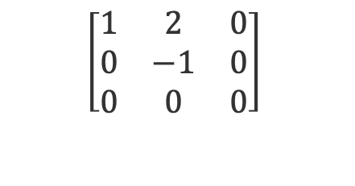

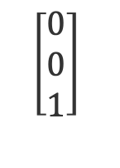

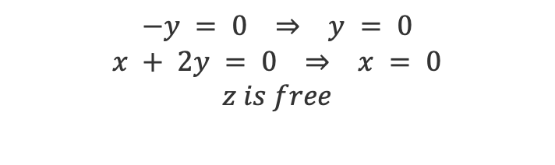
Example 3 (3×3) — Step 7: Eigenvector for λ = 2
Step 7 / 7
Solve (A − 2I)v = 0, then collect all three eigenpairs.
$$\left[\begin{matrix}1 & 2 & 0 \\ 0 & −1 & 0 \\ 0 & 0 & 0\end{matrix}\right]$$
$$−y = 0 ⇒ y = 0$$
$$x + 2y = 0 ⇒ x = 0$$
$$z is free$$
$$A − 2I =$$
$$\left[\begin{matrix}0 \\ 0 \\ 1\end{matrix}\right]$$
$$v =$$
$$Eigenpairs: λ = 3 → \left[\begin{matrix}1 & 0 & 0\end{matrix}\right] λ = 1 → \left[\begin{matrix}1 & −1 & 0\end{matrix}\right] λ = 2 → \left[\begin{matrix}0 & 0 & 1\end{matrix}\right]$$

Slide 40
Where the row equations come from (λ = 2)
Aside
(A − 2I)v = 0 is three equations in disguise — one for each row of the matrix.
Multiply A − 2I by v = (x, y, z), one row at a time. Each row becomes one plain equation:
Row 1: (1)x + (2)y + (0)z = 0 ⇒ x + 2y = 0 ⇒ x = −2y
Row 2: (0)x + (−1)y + (0)z = 0 ⇒ −y = 0 ⇒ y = 0, so x = 0
Row 3: (0)x + (0)y + (0)z = 0 ⇒ 0 = 0 ⇒ no information
Row 2 forces y = 0, and Row 1 then forces x = 0. Row 3 is entirely zero, so z is never constrained — z is the free direction here.
z is free. Choose z = 1 ⇒ v = (0, 0, 1). Any nonzero multiple of v is also an eigenvector.

Slide 41
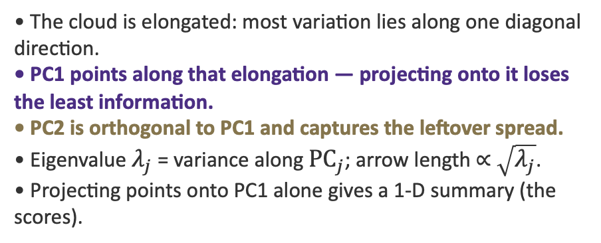
PCA — Geometric Intuition
Reading the picture
• The cloud is elongated: most variation lies along one diagonal direction.
• PC1 points along that elongation — projecting onto it loses the least information.
• PC2 is orthogonal to PC1 and captures the leftover spread.
• Eigenvalue $λ_{j}$ = variance along ${PC}_{j}$; arrow length ∝ $\sqrt{λ_{j}}$.
• Projecting points onto PC1 alone gives a 1-D summary (the scores).
PC1 (max variance)
PC2

Slide 42


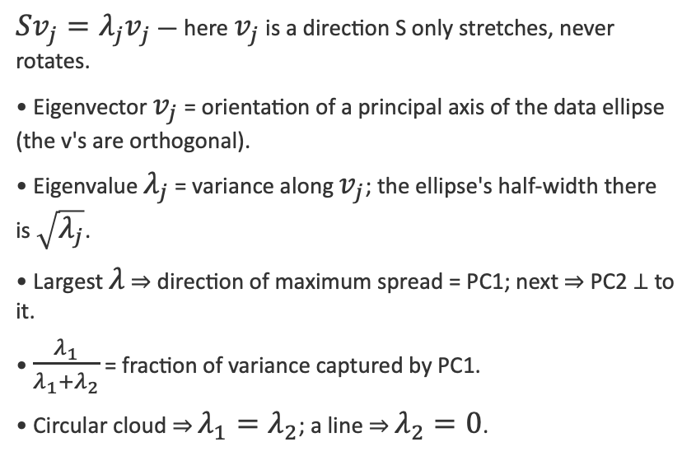
PCA — Eigenvectors & Eigenvalues in 2D
The covariance matrix S describes the shape of the data cloud. Its eigenvectors give the directions of the cloud's principal axes; its eigenvalues give the variance (spread²) along each.
What they mean geometrically
$Sv_{j}=λ_{j}v_{j}$ — here $v_{j}$ is a direction S only stretches, never rotates.
• Eigenvector $v_{j}$ = orientation of a principal axis of the data ellipse (the v's are orthogonal).
• Eigenvalue $λ_{j}$ = variance along $v_{j}$; the ellipse's half-width there is $\sqrt{λ_{j}}$.
• Largest $λ$ ⇒ direction of maximum spread = PC1; next ⇒ PC2 ⊥ to it.
• $\frac{λ_{1}}{λ_{1}+λ_{2}}$ = fraction of variance captured by PC1.
• Circular cloud ⇒ $λ_{1}=λ_{2}$; a line ⇒ $λ_{2}=0$.
$$v_{2} (\sqrt{λ_{2}})$$
$$v_{1} (\sqrt{λ_{1}})$$
Eigenvectors = axes of the data ellipse • eigenvalues = squared half-lengths

Slide 43
PCA — Graphical Representations
Three standard plots summarize a PCA. Each answers a different question.
Score plot
Loading plot
Biplot
Where do observations sit on PC1–PC2? Reveals clusters, gradients, outliers.
How does each original variable contribute to each PC? Arrows = variable directions.
Scores + loadings overlaid. Points near an arrow score high on that variable.
Interpretation checklist
• Axes carry % variance explained — always label them (e.g., "PC1 (62%)").
• Angle between two loading arrows ≈ correlation between those variables (small angle ⇒ positively correlated).
• Length of a loading arrow ⇒ how well that variable is represented in the plotted plane.
• Sign of a PC is arbitrary — only relative positions and directions are meaningful.

Slide 44
PCA — Reading a Biplot
How to read it
PC2 (23%)
• Three colored clusters → three sub-populations separated mainly along PC1.
• "Income" and "Age" arrows point right → high-PC1 observations are older, higher-income.
• "Income" and "Education" arrows are ~90° apart → roughly uncorrelated in this sample.
• A point far along an arrow's direction scores high on that variable.
• Axes show 54% + 23% = 77% of total variance captured in 2-D.
Education
Age
Income
PC1 (54%)

Slide 45

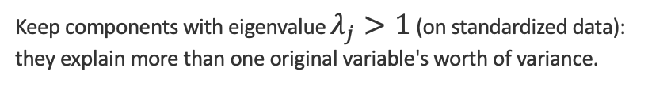
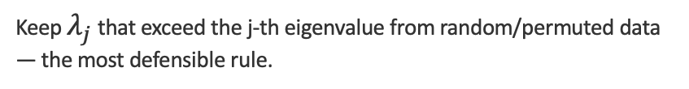
PCA — How Many Components to Keep
No single rule is definitive — use several and look for agreement.
Kaiser criterion
Keep components with eigenvalue $λ_{j}>1$ (on standardized data): they explain more than one original variable's worth of variance.
Scree / elbow
Plot $λ_{j} vs j$; keep components before the curve flattens into the 'rubble'.
Cumulative variance
Keep enough PCs to reach a target $Σλ$ share (e.g., 80–90%).
Parallel analysis
Keep $λ_{j}$ that exceed the j-th eigenvalue from random/permuted data — the most defensible rule.

Slide 46

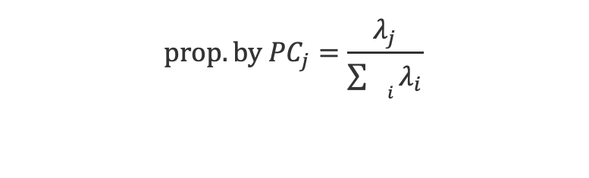

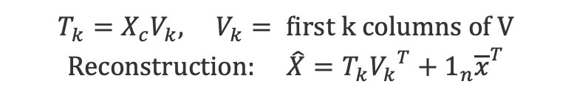

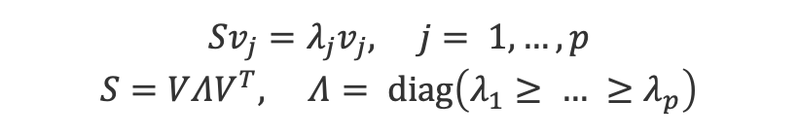
PCA — Matrix Formulation
Data matrix X ∈ ℝⁿˣᵖ : n observations (rows), p variables (columns). Center each column to mean 0; standardize if scales differ.
1 · Centering
4 · Loadings & scores
$$X_{c}=X−1_{n}{\overline{x}}^{T}, \overline{x}=\frac{1}{n}X^{T}1_{n}$$
Loadings: columns of V (eigenvectors)
$$Scores: T=X_{c}V (n×p)$$
2 · Covariance matrix (p×p)
5 · k-dim projection
$$S=\frac{1}{n−1}{X_{c}}^{T}X_{c}$$
$$T_{k}=X_{c}V_{k}, V_{k}= first k columns of V$$
$$Reconstruction: \hat{X}=T_{k}{V_{k}}^{T}+1_{n}{\overline{x}}^{T}$$
3 · Eigen-decomposition
6 · Variance explained
$$Sv_{j}=λ_{j}v_{j}, j= 1,…,p$$
$$S=VΛV^{T}, Λ= diag\left(λ_{1}≥ … ≥λ_{p}\right)$$
$$prop. by {PC}_{j}=\frac{λ_{j}}{\sum_{{}_{i}}{λ_{i}}}$$

Slide 47
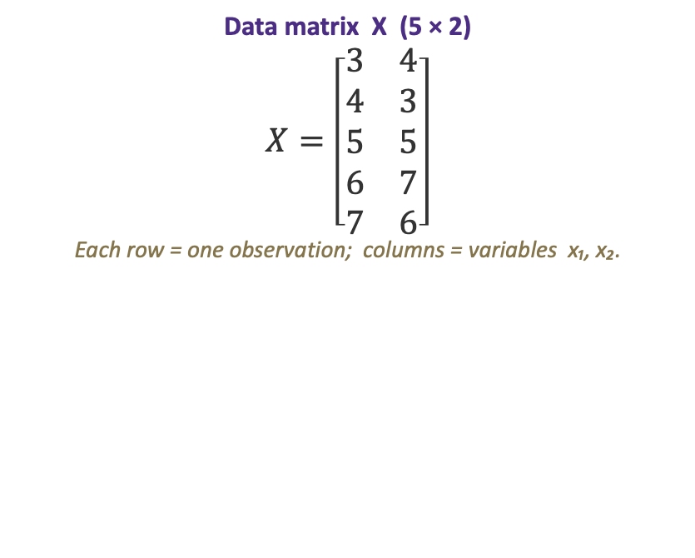
Worked Example: A 5×2 Data Matrix
n = 5 observations (rows), p = 2 variables (columns). We will run the full PCA by hand, then plot the result.
Data matrix X (5 × 2)
$$X=\left[\begin{matrix}3 & 4 \\ 4 & 3 \\ 5 & 5 \\ 6 & 7 \\ 7 & 6\end{matrix}\right]$$
Each row = one observation; columns = variables x₁, x₂.

Slide 48
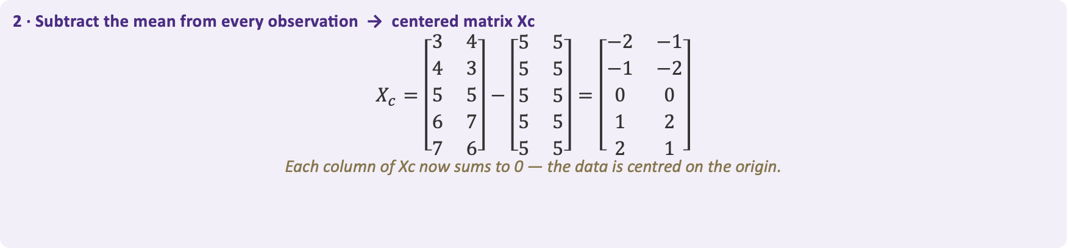

Step 1 · Centering
Subtract each column's mean so every variable is mean-zero — the operation is Xc = X − 1ₙ x̄ᵀ.
1 · Column means → mean vector x̄
$$\bar{x}=\left[\begin{matrix}5 & 5\end{matrix}\right]$$
x̄₁ = (3+4+5+6+7)/5 = 5 x̄₂ = (4+3+5+7+6)/5 = 5
2 · Subtract the mean from every observation → centered matrix Xc
$$X_{c}=\left[\begin{matrix}3 & 4 \\ 4 & 3 \\ 5 & 5 \\ 6 & 7 \\ 7 & 6\end{matrix}\right]−\left[\begin{matrix}5 & 5 \\ 5 & 5 \\ 5 & 5 \\ 5 & 5 \\ 5 & 5\end{matrix}\right]=\left[\begin{matrix}−2 & −1 \\ −1 & −2 \\ 0 & 0 \\ 1 & 2 \\ 2 & 1\end{matrix}\right]$$
Each column of Xc now sums to 0 — the data is centred on the origin.

Slide 49
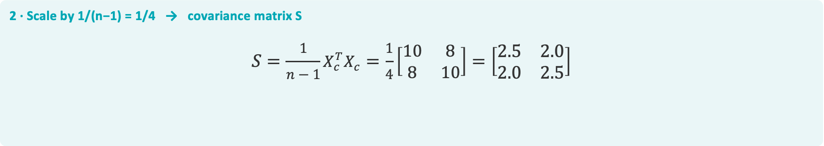

Step 2 · Covariance Matrix
Multiply the centered matrix by its transpose and scale — S = 1/(n−1) · Xcᵀ Xc (a 2×2 matrix).
1 · Matrix product $X_{c}^{T}X_{c}$ (2×5 · 5×2 → 2×2)
$$X_{c}^{T}X_{c}=\left[\begin{matrix}−2 & −1 & 0 & 1 & 2 \\ −1 & −2 & 0 & 2 & 1\end{matrix}\right]·\left[\begin{matrix}−2 & −1 \\ −1 & −2 \\ 0 & 0 \\ 1 & 2 \\ 2 & 1\end{matrix}\right]=\left[\begin{matrix}10 & 8 \\ 8 & 10\end{matrix}\right]$$
diagonal = Σ(column)² → (−2)²+(−1)²+0²+1²+2² = 10 off-diagonal = Σ(col₁·col₂) = 2+2+0+2+2 = 8
2 · Scale by 1/(n−1) = 1/4 → covariance matrix S
$$S=\frac{1}{n−1}X_{c}^{T}X_{c}=\frac{1}{4}\left[\begin{matrix}10 & 8 \\ 8 & 10\end{matrix}\right]=\left[\begin{matrix}2.5 & 2.0 \\ 2.0 & 2.5\end{matrix}\right]$$

Slide 50


Slide 51



Step 3 · Eigenvalues
Part 1 of 3 — solve the characteristic equation det(S − λI) = 0 for the two eigenvalues.
1 · Subtract λ from the diagonal of S
$$S − λI = \left[\begin{matrix}2.5 & 2 \\ 2 & 2.5\end{matrix}\right] − λ\left[\begin{matrix}1 & 0 \\ 0 & 1\end{matrix}\right] = \left[\begin{matrix}2.5 − λ & 2 \\ 2 & 2.5 − λ\end{matrix}\right]$$
2 · Set the determinant to zero
$$det\left|\begin{matrix}2.5 − λ & 2 \\ 2 & 2.5 − λ\end{matrix}\right| = {\left(2.5 − λ\right)}^{2} − 4 = 0$$
expand: (2.5 − λ)(2.5 − λ) − (2)(2) = (2.5 − λ)² − 4
3 · Solve for λ
$${\left(2.5 − λ\right)}^{2} = 4 ⇒ 2.5 − λ = ± 2 ⇒ λ = 2.5 ∓ 2$$
⇒ λ₁ = 4.5 λ₂ = 0.5

Slide 52



Step 3 · Eigenvector for λ₁ = 4.5
Part 2 of 3 — solve (S − λ₁I)v₁ = 0, then normalize to unit length.
1 · Form (S − λ₁I) with λ₁ = 4.5
$$S − 4.5 I = \left[\begin{matrix}2.5 − 4.5 & 2 \\ 2 & 2.5 − 4.5\end{matrix}\right] = \left[\begin{matrix}−2 & 2 \\ 2 & −2\end{matrix}\right]$$
2 · Solve the homogeneous system (S − λ₁I)v₁ = 0 (let v₁ = [a, b]ᵀ)
$$\left[\begin{matrix}−2 & 2 \\ 2 & −2\end{matrix}\right]\left[\begin{matrix}a \\ b\end{matrix}\right] = \left[\begin{matrix}0 \\ 0\end{matrix}\right] ⇒ −2a + 2b = 0 ⇒ a = b$$
$$so v₁ ∝ \left[\begin{matrix}1 \\ 1\end{matrix}\right] (choose a = b = 1)$$
3 · Normalize to unit length
$$‖\left[\begin{matrix}1 \\ 1\end{matrix}\right]‖ = √(1² + 1²) = √2 ⇒ v₁ = 1/√2 \left[\begin{matrix}1 \\ 1\end{matrix}\right] = \left[\begin{matrix}0.707 \\ 0.707\end{matrix}\right]$$

Slide 53



Step 3 · Eigenvector for λ₂ = 0.5
Part 2 of 3 (continued) — solve (S − λ₂I)v₂ = 0, then normalize to unit length.
1 · Form (S − λ₂I) with λ₂ = 0.5
$$S − 0.5 I = \left[\begin{matrix}2.5 − 0.5 & 2 \\ 2 & 2.5 − 0.5\end{matrix}\right] = \left[\begin{matrix}2 & 2 \\ 2 & 2\end{matrix}\right]$$
2 · Solve the homogeneous system (S − λ₂I)v₂ = 0 (let v₂ = [a, b]ᵀ)
$$\left[\begin{matrix}2 & 2 \\ 2 & 2\end{matrix}\right]\left[\begin{matrix}a \\ b\end{matrix}\right] = \left[\begin{matrix}0 \\ 0\end{matrix}\right] ⇒ 2a + 2b = 0 ⇒ a = −b$$
$$so v₂ ∝ \left[\begin{matrix}1 \\ −1\end{matrix}\right] (choose a = 1, b = −1)$$
3 · Normalize to unit length
$$‖\left[\begin{matrix}1 \\ −1\end{matrix}\right]‖ = √(1² + (−1)²) = √2 ⇒ v₂ = 1/√2 \left[\begin{matrix}1 \\ −1\end{matrix}\right] = \left[\begin{matrix}0.707 \\ −0.707\end{matrix}\right]$$

Slide 54



Step 3 · Assemble S = VΛVᵀ
Part 3 of 3 — collect the eigenvectors into V (columns) and eigenvalues into Λ (diagonal).
1 · Eigenvectors → columns of V
$$V = [ v₁ v₂ ] = \left[\begin{matrix}0.707 & 0.707 \\ 0.707 & −0.707\end{matrix}\right]$$
2 · Eigenvalues → diagonal of Λ (largest first)
$$Λ = diag(λ₁, λ₂) = \left[\begin{matrix}4.5 & 0 \\ 0 & 0.5\end{matrix}\right]$$
3 · Spectral decomposition
$$S = VΛV^{T} = \left[\begin{matrix}2.5 & 2 \\ 2 & 2.5\end{matrix}\right] ✓$$
V is orthogonal (VᵀV = I), so Vᵀ = V⁻¹ — multiplying back reproduces S exactly.

Slide 55


Step 4 · Loadings & Scores
Loadings are the columns of V; scores are the centred data projected onto them — T = Xc V.
1 · Loadings = columns of V (the weight of each variable on each PC)
$$p₁ = \left[\begin{matrix}0.707 \\ 0.707\end{matrix}\right] (PC1) p₂ = \left[\begin{matrix}0.707 \\ −0.707\end{matrix}\right] (PC2)$$
2 · Scores T = Xc V (project the centred data onto the eigenvectors)
$$T = X_{c}V = \left[\begin{matrix}−2 & −1 \\ −1 & −2 \\ 0 & 0 \\ 1 & 2 \\ 2 & 1\end{matrix}\right]\left[\begin{matrix}0.707 & 0.707 \\ 0.707 & −0.707\end{matrix}\right] = \left[\begin{matrix}−2.121 & −0.707 \\ −2.121 & 0.707 \\ 0 & 0 \\ 2.121 & −0.707 \\ 2.121 & 0.707\end{matrix}\right]$$
Columns of T are the PC1 and PC2 coordinates. Row 1: (−2)(0.707)+(−1)(0.707) = −2.121 on PC1.

Slide 56

Step 5 · Variance Explained
Each eigenvalue is the variance along its PC; divide by the total to get the share — λⱼ / Σλ.
Proportion of variance per PC
$$prop. PCⱼ = \frac{λⱼ}{λ₁ + λ₂}$$
Total variance: λ₁ + λ₂ = 4.5 + 0.5 = 5.0
PC1 : 4.5 / 5 = 0.90 → 90%
PC2 : 0.5 / 5 = 0.10 → 10%
Cumulative: PC1 = 90%, PC1 + PC2 = 100%

Slide 57
Step 6 · Plotting the Biplot
Plot the scores in PC space and overlay each original variable as a vector from the origin.
Plotting PC1, PC2 & the variable vectors
1 · Axes = the PCs. PC1 on the x-axis, PC2 on the y-axis; the origin is the data mean.
2 · Plot the scores. Place each row of T at its (PC1, PC2) — e.g. obs 1 → (−2.12, −0.71).
3 · Draw variable arrows. From the origin along each variable's loadings (a row of V): x₁ → (0.707, 0.707), x₂ → (0.707, −0.707).
4 · Interpret. Arrow direction = how a variable aligns with the PCs; points spread mostly along PC1 (90% of variance).
PC2 (10%)
x₁
2 (−2.121, 0.707)
5 (2.121, 0.707)
3 (0, 0)
PC1 (90%)
1 (−2.121, −0.707)
4 (2.121, −0.707)
x₂

Slide 58
PCA via Singular Value Decomposition
In practice PCA is computed from the SVD of the centered data — more numerically stable than forming S = X꜀ᵀX꜀ explicitly.
$$X_{c}=UΣV^{T}$$
U (n×n)
Σ (n×p)
V (p×p)
Left singular vectors — orthonormal
Diagonal singular values σ₁ ≥ σ₂ ≥ …
Right singular vectors = PCA loadings

Slide 59

Exercise 1 — The Problem
Exercise 1 · 1 / 4
Given — covariance matrix S
$$S = \left[\begin{matrix}5 & 2 \\ 2 & 2\end{matrix}\right]$$
Find
(a) the eigenvalues of S
(b) the unit eigenvector for the larger eigenvalue
(c) the fraction of total variance explained by PC1

Slide 60


Exercise 1 — Solution (a): Eigenvalues
Exercise 1 · 2 / 4
1 · Characteristic equation det(S − λI) = 0
$$det\left|\begin{matrix}5 − λ & 2 \\ 2 & 2 − λ\end{matrix}\right| = \left(5 − λ\right)\left(2 − λ\right) − 4 = 0$$
2 · Expand and factor
$$λ^{2} − 7λ + 6 = 0 ⇒ (λ − 6)(λ − 1) = 0$$
3 · Eigenvalues
λ₁ = 6 λ₂ = 1

Slide 61


Exercise 1 — Solution (b): Unit Eigenvector
Exercise 1 · 3 / 4
1 · Solve (S − λ₁I)v = 0 for λ₁ = 6
$$(5 − 6)v₁ + 2v₂ = 0 ⇒ −v₁ + 2v₂ = 0 ⇒ v₁ = 2v₂$$
2 · Pick a vector, then normalize to unit length
$$v = (2, 1), ‖v‖ = √(2² + 1²) = √5$$
$$v₁ = (1/√5)(2, 1) = (0.894, 0.447)$$
3 · Second eigenvector (orthogonal)
$$v₂ = (−0.447, 0.894)$$
perpendicular to v₁ and also unit length

Slide 62


Exercise 1 — Solution (c): Variance Explained
Exercise 1 · 4 / 4
1 · Total variance = trace of S
$$tr(S) = 5 + 2 = 7 = λ₁ + λ₂ ✓$$
2 · Fraction of variance carried by PC1
$$PC1 share = \frac{λ₁}{λ₁ + λ₂} = \frac{6}{7} = 0.857$$
3 · Answer
PC1 explains ≈ 85.7% of the total variance

Slide 63

Exercise 2 — The Problem
Exercise 2 · 1 / 4
Given — eigenvalues from 6 standardized variables
$$λ = (3.1, 1.4, 0.7, 0.4, 0.25, 0.15)$$
standardized data → total variance Σλ = 6
Find
(a) how many components the Kaiser rule (λ > 1) keeps
(b) how many components are needed to reach ≥ 80% cumulative variance
(c) where the elbow of the scree plot lies

Slide 64

Exercise 2 — Solution (a): Kaiser Rule
Exercise 2 · 2 / 4
1 · The Kaiser rule
Keep every component with λⱼ > 1. For standardized data the average eigenvalue is exactly 1, so this retains the above-average components.
2 · Compare each eigenvalue with 1
$$3.1 > 1 ✓ 1.4 > 1 ✓ 0.7$$
3 · Answer
Kaiser keeps 2 components — PC1 and PC2

Slide 65
Exercise 2 — Solution (b): Cumulative Variance
Exercise 2 · 3 / 4
1 · Variance share (λⱼ / 6)
PC1: 3.1 / 6 = 51.7%
PC2: 1.4 / 6 = 23.3%
PC3: 0.7 / 6 = 11.7%
2 · Cumulative
PC1 = 51.7%
PC1+PC2 = 75.0%
PC1+PC2+PC3 = 86.7% ← first ≥ 80%
3 · Answer
3 components are needed to exceed 80%

Slide 66
Exercise 2 — Solution (c): Scree Elbow
Exercise 2 · 4 / 4
1 · Drops between successive eigenvalues
3.1 → 1.4 (big drop, −1.7)
1.4 → 0.7 (−0.7)
0.7 → 0.4 → 0.25 → 0.15 (small, flat tail)
2 · Where is the elbow?
the curve flattens after PC2 → elbow at 2 components
3 · Takeaway
Kaiser and the scree elbow agree on 2; the 80% rule wants 3. Rules can disagree — state your choice and the variance retained.

Slide 67
Exercise 3 — The Problem
Exercise 3 · 1 / 4
Answer these conceptual questions about PCA
(a) Why must the data be centred before running PCA?
(b) When should you use the correlation matrix R instead of the covariance matrix S?
(c) A colleague keeps the PCs with the largest loading magnitudes — not the largest eigenvalues. What is wrong with that?

Slide 68
Exercise 3 — Solution (a): Why Centre the Data?
Exercise 3 · 2 / 4
The principle
PCA looks for the directions of maximum variance about the mean — spread is always measured relative to the data's centroid.
Without centring
The first component is pulled toward the mean vector (the origin → centroid direction). It then measures squared distance from the origin, not spread — so the decomposition no longer describes variance at all.
Takeaway
Always subtract each column's mean first: Xc = X − 1ₙ x̄ᵀ.

Slide 69
Exercise 3 — Solution (b): Correlation R vs Covariance S
Exercise 3 · 3 / 4
Use the correlation matrix R
When variables are on different units or scales. Standardizing makes every variable have variance 1, so a high-variance unit (e.g. income in dollars) can't dominate PC1 just because of its scale.
Use the covariance matrix S
When all variables share comparable units and their differing variances are meaningful and worth preserving.
Rule of thumb
Different units → R. Same units → S.

Slide 70
Exercise 3 — Solution (c): Eigenvalue vs Loading
Exercise 3 · 4 / 4
The mistake
Ranking the principal components by their largest loading magnitude instead of by their eigenvalue.
Why it is wrong
The eigenvalue λⱼ is the variance captured by a component; a loading only describes one variable's contribution to that direction. A component can have a large single loading yet a tiny eigenvalue — carrying very little total variance.
Correct rule
Rank components by their eigenvalues λⱼ — never by any individual loading.

Slide 71
02
Correspondence Analysis
Mapping the association in a contingency table

Slide 72


Correspondence Analysis — The Core Idea
CA is "PCA for categorical data": it turns a contingency table of counts into a low-dimensional map where row and column categories with similar profiles sit close together.
Input
What it preserves
Output
A two-way contingency table N (counts) — e.g., brands × attributes, regions × responses.
$χ^{2}$distances between row profiles (and between column profiles), not raw Euclidean distance.
A biplot: rows and columns as points in the same space; proximity ⇒ association.
Central concept — profiles & inertia
• Row profile = a row divided by its total (a conditional distribution across columns).
• If two rows have identical profiles, they coincide in the map; rows far from the centroid are 'distinctive'.
• Total inertia = $\frac{χ^{2}}{n}$ measures how far the table departs from independence — CA decomposes
this inertia into orthogonal dimensions, exactly as PCA decomposes variance.

Slide 73
Correspondence Analysis — The Intuition
CA is PCA for categorical contingency tables — it turns a cross-tab into a map.
The data: a contingency table
What CA asks
Which rows have similar distributions across the columns?
Which columns tend to be associated with which rows?
 | Cat A | Cat B | Cat C
Group 1 | 20 | 10 | 5
Group 2 | 5 | 25 | 10
Group 3 | 10 | 8 | 22
What you get
A low-dimensional map — usually 2-D — where rows with similar profiles sit close together, and so do similar columns. A row near a column suggests they are associated.

Slide 74
The χ² Test for Contingency Tables
Testing whether two categorical variables are independent.
H₀ — Null hypothesis
The row and column variables are independent: the observed counts match what independence would predict.
H₁ — Alternative hypothesis
The two variables are associated: the observed counts depart from the independence pattern.
The idea
Compare each observed count O with the count E expected under independence. Large gaps are evidence of association.

Slide 75
The Test Statistic
Total squared departure from independence, scaled by the expected counts.
1 · Expected counts under H₀
Eᵢⱼ = (rowᵢ × colⱼ) ⁄ n
2 · The χ² statistic
χ² = ∑ᵢ ∑ⱼ (Oᵢⱼ − Eᵢⱼ)² ⁄ Eᵢⱼ
sums the standardized squared gaps over every cell
3 · Distribution and decision
Under H₀, χ² follows a χ² distribution with df = (I−1)(J−1). Reject H₀ when χ² exceeds the critical value (p

Slide 76
Example — Step 1: The Data
Is hair color associated with eye color? (n = 100)
Observed counts (O)
 | Blue | Brown | Total
Fair | 30 | 10 | 40
Dark | 10 | 50 | 60
Total | 40 | 60 | 100
The hypotheses
H₀ (independence)
Hair color and eye color are independent — no association.
H₁ (association)
Hair color and eye color are associated.

Slide 77
Expected counts (E)
Example — Step 2: Expected Counts
 | Blue | Brown
Fair | 16 | 24
Dark | 24 | 36
Under H₀, each cell's expected count is row × column ÷ n.
The rule
Eᵢⱼ = (rowᵢ × colⱼ) / n
Cell by cell
Observed counts (O)
E(Fair, Blue) = 40 × 40 / 100 = 16
E(Fair, Brown) = 40 × 60 / 100 = 24
E(Dark, Blue) = 60 × 40 / 100 = 24
E(Dark, Brown) = 60 × 60 / 100 = 36
 | Blue | Brown
Fair | 30 | 10
Dark | 10 | 50
Expected counts are what we'd see if hair and eye color were perfectly independent. The χ² statistic measures how far the observed counts stray from these.

Slide 78
Example — Step 3: The χ² Statistic
Add up (O − E)² / E across all four cells.
Cell contributions (O − E)² / E
(30 − 16)² / 16 = 12.25
(10 − 24)² / 24 = 8.17
(10 − 24)² / 24 = 8.17
(50 − 36)² / 36 = 5.44
Total
χ² = 12.25 + 8.17 + 8.17 + 5.44 = 34.03

Slide 79
Example — Step 4: Degrees of Freedom & Decision
Compare the statistic with the critical value.
Degrees of freedom
Critical value (α = 0.05)
df = (I − 1)(J − 1)
= (2 − 1)(2 − 1) = 1
χ²_{0.95}(df = 1) = 3.84
i.e. the 0.95 percentile — 5% of the distribution lies above it
Decision
χ² = 34.03 > 3.84 ⇒ reject H₀ (p < 0.001)
The data show a strong association between hair color and eye color.

Slide 80
Connecting the χ² Test and CA
Correspondence Analysis decomposes the very same χ².
Same quantity, two views
χ² = n × total inertia ⇒ total inertia = χ² / n = 34.03 / 100 = 0.3403
What CA adds
CA splits the total inertia into orthogonal dimensions — the principal inertias σ²ₖ that sum to the total. Each dimension captures part of the association.
The big picture
The χ² test tells you IF an association exists; CA shows you WHERE it comes from — which rows and columns drive it, and on which dimensions.

Slide 81
Reading a CA Map
CA is "PCA for categorical data": it turns a contingency table of counts into a low-dimensional map where row and column categories with similar profiles sit close together.
Proximity = similarity
Rows close together have similar column profiles.
Columns close together have similar row profiles.
A row point near a column point suggests the two categories are associated.
Distance from the origin
Points near the origin match the average, the independence pattern.
Points far from the origin contribute more to the association structure.
CA turns a cross-tab into a picture of which row and column categories go together.

Slide 82



CA Decomposes the Pearson χ²
CA does not maximize counts; it studies deviations from independence.
1 · Proportions and masses
$$P = \frac{N}{n} r = P1 c = P^{T}1$$
2 · Standardized residuals (departure from independence rcᵀ)
$$S = D_{r}^{−1/2}\left(P − rc^{T}\right)D_{c}^{−1/2}$$
3 · SVD gives the principal inertias
$$S = UΣV^{T} total inertia = Σσ^{2}ₖ = \frac{χ²}{n} ⇒ χ² = n · inertia$$

Slide 83
CA Decomposes the Pearson χ²
CA does not maximize counts; it studies deviations from independence.
The objective
CA finds the dimensions that capture the largest share of χ² inertia. The first axis explains the largest departure from independence; each later axis is orthogonal and explains the largest remaining part.
PCA
CA
• Maximizes variance
• Uses Euclidean distance
• For continuous variables
• Maximizes χ² inertia
• Uses chi-square distance
• For categorical profiles
CA shows which row and column categories are responsible for the association in a contingency table.

Slide 84
Correspondence Analysis — Reading the Map
How to read it
Dim 2 (27%)
• Near the origin = average profile (close to independence); far out = distinctive.
• Row–row / col–col proximity ⇒ similar profiles.
• Row near a column point ⇒ that combination occurs more than independence predicts (positive association).
• Axis % = share of total inertia explained by that dimension; report them like PCA variance.
• Caution (symmetric map): row–column distances are only suggestive — strictly, interpret each cloud's geometry separately.
C: Sport
R: Young
R: Mid
C: Sedan
Dim 1 (58%)
R: Senior
C: Luxury
● rows (e.g. age groups) ▲ columns (e.g. car type)

Slide 85




CA — How Many Dimensions to Keep
The map has at most K = min(I−1, J−1) dimensions for an I×J table. Choose how many to display.
Inertia explained
Scree of inertia
Average rule
Interpretability
Each dimension k explains $\frac{λ_{k}}{Σλ}$ of total inertia. Keep enough to reach ~70–80%.
Plot $λ_{k} vs k$; keep dimensions before the elbow — same logic as PCA's scree plot.
Keep dimensions with $λ_{k} > \bar{λ}$, where $\bar{λ} = (total inertia)/K$ (CA analogue of Kaiser).
Two dimensions are usually plotted for a readable biplot; a 3rd only if clearly meaningful.
Worked illustration
A 4×5 table ⇒ $K= min(3,4) = 3$ possible dimensions. Suppose principal inertias
$λ= (0.182, 0.071, 0.014)$, total inertia = 0.267.
Shares: Dim1 = 68.2%, Dim2 = 26.6%, Dim3 = 5.2%. Dim1+Dim2 = 94.8% ⇒ a 2-D map is more than adequate.
Average rule: $\bar{λ} = 0.267/3 = 0.089$; only Dim1 (0.182) exceeds it — but we still plot Dim2 for a 2-D picture.

Slide 86



CA — Matrix Formulation (1): Profiles & Inertia
Start from the I×J count table N with grand total n. Work with proportions, masses, and expected values.
Correspondence matrix & masses
Profiles
$$P=\frac{N}{n} (sums to 1)$$
$$Row mass r_{i}=\sum_{j}{p_{ij}} Col mass c_{j}=\sum_{i}{p_{ij}}$$
$$(vectors r, c)$$
$$D_{r}= diag(r), D_{c}= diag(c)$$
$$Expected: E=rc^{T}$$
$$Row profile i: \frac{p_{ij}}{r_{i}} (row of {D_{r}}^{−1}P)$$
$$Col profile j: \frac{p_{ij}}{c_{j}} (col of P{D_{c}}^{−1})$$
Row profiles live in the simplex of column categories; their weighted average (centroid) = c.
Total inertia = χ²/n
$$χ^{2}=\sum_{i}{}\sum_{j}{}\frac{{\left(N_{ij}−E_{ij}\right)}^{2}}{E_{ij}}, E_{ij}=nr_{i}c_{j}$$
$$Total inertia Φ^{2}=\frac{χ^{2}}{n}=\sum_{i}{}\sum_{j}{}\frac{{\left(p_{ij}−r_{i}c_{j}\right)}^{2}}{r_{i}c_{j}}$$
Φ² = weighted sum of squared χ²-distances of row profiles to their centroid c.
CA finds orthogonal axes that successively capture the largest share of this total inertia.

Slide 87




CA — Matrix Formulation (2): SVD & Coordinates
Step 1 — Standardized residual matrix
$S={D_{r}}^{\frac{−1}{2}}\left(P−rc^{T}\right){D_{c}}^{\frac{−1}{2}}$ standardized residuals, $S_{ij}=\frac{p_{ij}−r_{i}c_{j}}{\sqrt{r_{i}c_{j}}}$
Note: $\sum_{ij}{}S_{ij}^{2}=Φ^{2}$ = total inertia.
Step 2 — SVD of S
Step 3 — Principal coordinates
$$S=UD_{α}V^{T}, D_{α}= diag\left(α_{1}≥α_{2}≥…\right)$$
$$Principal inertias λ_{k}=α_{k}^{2} \sum_{k}{}λ_{k}=Φ^{2} axis share =\frac{λ_{k}}{Φ^{2}}$$
$$Rows: F={D_{r}}^{\frac{−1}{2}}UD_{α} (I×K)$$
$$Cols: G={D_{c}}^{\frac{−1}{2}}VD_{α} (J×K)$$
Plot columns k=1,2 of F and G → the symmetric CA map.
Diagnostics — contributions & quality
Contribution of row i to axis k: ${CTR}_{ik}=\frac{r_{i}F_{ik}^{2}}{λ_{k}}$ (which categories build an axis)
Quality (cos²): ${COR}_{ik}=\frac{F_{ik}^{2}}{\sum_{k}{}F_{ik}^{2}}$ (how well point i is shown)

Slide 88




CA — Computation Algorithm
1
Build P = N/n
2
Masses r, c
3
Residual matrix S
Divide the contingency table by its grand total.
Row sums $r=P1$, col sums $c=P^{T}1$; form $D_{r}$, $D_{c}$.
$$S={D_{r}}^{\frac{−1}{2}}\left(P−rc^{T}\right){D_{c}}^{\frac{−1}{2}}$$
4
SVD S = U Dₐ Vᵀ
5
Coordinates F, G
6
Plot & diagnose
Principal inertias $λ_{k}=α_{k}^{2}$; shares $\frac{λ_{k}}{Σλ}$.
$F={D_{r}}^{\frac{−1}{2}}UD_{α}$, $G={D_{c}}^{\frac{−1}{2}}VD_{α}$.
Plot dims 1–2; report contributions & cos² quality.

Slide 89



CA Example 1 — Step 1: Table & Masses
CA Example 1 · 1 / 6
1 · Contingency table N (Hair × Eye)
$$N = \left[\begin{matrix}30 & 10 \\ 10 & 50\end{matrix}\right]$$
rows = Fair, Dark · columns = Blue, Brown · totals 40/60, grand total n = 100
2 · Correspondence matrix P = N / n
$$P = \left[\begin{matrix}0.30■ & 0.10■ \\ 0.10■ & 0.50■\end{matrix}\right]$$
digit colour = row mass · square marker = column mass
3 · Masses (margins of P)
$$r = (0.40, 0.60)$$
$$c = (0.40■, 0.60■)$$

Slide 90


CA Example 1 — Step 2: Expected Counts & χ²
CA Example 1 · 2 / 6
1 · Expected counts under independence Eᵢⱼ = (rowᵢ · colⱼ) / n
$$E = \left[\begin{matrix}16 & 24 \\ 24 & 36\end{matrix}\right]$$
e.g. E₁₁ = 40·40 / 100 = 16, E₂₂ = 60·60 / 100 = 36
2 · Chi-square statistic χ² = Σ (O − E)² / E
$$χ² = (30−16)²/16 + (10−24)²/24 + (10−24)²/24 + (50−36)²/36$$
$$= 12.25 + 8.17 + 8.17 + 5.44$$
3 · Result
χ² = 34.03

Slide 91



CA Example 1 — Step 3: Total Inertia
CA Example 1 · 3 / 6
1 · Total inertia = χ² / n
$$Φ² = χ² / n = 34.03 / 100 = 0.3403$$
2 · How many dimensions?
$$K = min(I − 1, J − 1) = min(1, 1) = 1$$
a 2×2 table needs only one axis — it captures 100% of the inertia
3 · Interpretation
$$√Φ² = √0.3403 = 0.583$$
the single axis carries 100% of the inertia · 0.583 is the row–column score correlation, a strong Hair–Eye association

Slide 92


CA Example 1 — Step 4: Standardized Residuals
CA Example 1 · 4 / 6
1 · Standardized residual Sᵢⱼ = (pᵢⱼ − rᵢcⱼ) / √(rᵢcⱼ)
$$r cᵀ = \left[\begin{matrix}0.16 & 0.24 \\ 0.24 & 0.36\end{matrix}\right] (the independence model)$$
2 · Compute each entry
$$\frac{P−r cᵀ}{\sqrt{r cᵀ}}= \frac{\left[\begin{matrix}0.30 & 0.10 \\ 0.10 & 0.50\end{matrix}\right]−\left[\begin{matrix}0.16 & 0.24 \\ 0.24 & 0.36\end{matrix}\right]}{\sqrt{\left[\begin{matrix}0.16 & 0.24 \\ 0.24 & 0.36\end{matrix}\right]}} = \left[\begin{matrix}0.350 & −0.286 \\ −0.286 & 0.233\end{matrix}\right]$$
e.g. S₁₁ = (0.30 − 0.16) / √0.16 = 0.14 / 0.40 = 0.350
3 · Check
Σ Sᵢⱼ² = 0.350² + 0.286² + 0.286² + 0.233² = 0.340 = Φ² ✓

Slide 93

CA Example 1 — Step 5: Coordinates
CA Example 1 · 5 / 6
1 · One axis from the SVD of S (S = α₁ u₁ v₁ᵀ)
$$α₁ = √0.340 = 0.583 → principal coord = α₁ × (standard coord)$$
S has rank 1, so a single axis reproduces it exactly
2 · Principal coordinates on dimension 1
Rows: Fair = +0.714 Dark = −0.476
Columns: Blue = +0.714 Brown = −0.476
3 · Sanity checks
weighted mean = 0.4(+0.714) + 0.6(−0.476) = 0 ✓ inertia = 0.4(0.714²) + 0.6(0.476²) = 0.340 = λ₁ ✓

Slide 94

CA Example 1 — Step 5a: SVD of S
CA Example 1 · 5a
1 · The standardised residual matrix S (from Step 4)
$$S = \left[\begin{matrix}0.350 & −0.286 \\ −0.286 & 0.233\end{matrix}\right]$$
2 · Singular value α₁ = √(Σ Sᵢⱼ²)
Σ Sᵢⱼ² = 0.350² + (−0.286)² + (−0.286)² + 0.233²
= 0.1225 + 0.0818 + 0.0818 + 0.0544 = 0.3403
α₁ = √0.3403 = 0.583 λ₁ = α₁² = 0.340 = Φ² (100% of inertia)
3 · Singular vectors (rank 1, so only one pair)
u₁ = (+0.774, −0.632) v₁ = (+0.774, −0.632)
check: α₁ u₁₁ v₁₁ = 0.583 × 0.774 × 0.774 = 0.350 = S₁₁ ✓

Slide 95
CA Example 1 — Step 5b: Standard Coordinates
CA Example 1 · 5b
1 · Rows: φ = u₁ ÷ √r (divide each u by the square root of its row mass)
Fair: φ₁ = +0.774 / √0.40 = +0.774 / 0.632 = +1.224
Dark: φ₂ = −0.632 / √0.60 = −0.632 / 0.775 = −0.816
2 · Columns: ψ = v₁ ÷ √c (same arithmetic with the column masses)
Blue: ψ₁ = +0.774 / √0.40 = +0.774 / 0.632 = +1.224
Brown: ψ₂ = −0.632 / √0.60 = −0.632 / 0.775 = −0.816
rows and columns coincide here because P is symmetric
3 · Check — standard coordinates are centred and scaled to 1
mean: 0.4(+1.224) + 0.6(−0.816) = 0.490 − 0.490 = 0 ✓
variance: 0.4(1.224²) + 0.6(0.816²) = 0.599 + 0.400 = 1.000 ✓

Slide 96
CA Example 1 — Step 5c: Principal Coordinates
CA Example 1 · 5c
1 · Rows: F = α₁ × φ (stretch the standard coordinates by the singular value)
Fair: F₁ = 0.583 × (+1.224) = +0.714
Dark: F₂ = 0.583 × (−0.816) = −0.476
2 · Columns: G = α₁ × ψ
Blue: G₁ = 0.583 × (+1.224) = +0.714
Brown: G₂ = 0.583 × (−0.816) = −0.476
these are the numbers plotted on the CA map
3 · Reading the axis
Fair hair and Blue eyes sit together on the positive side;
Dark hair and Brown eyes on the negative side — the association the χ² test detected.

Slide 97
CA Example 1 — Step 5d: Cross-check via Profiles
CA Example 1 · 5d
1 · Row profiles (each row of N divided by its own total)
Fair = (30/40, 10/40) = (0.750, 0.250) Dark = (10/60, 50/60) = (0.167, 0.833)
centroid = column masses c = (0.400, 0.600)
2 · χ² distance of each profile from the centroid: d² = Σ (profileⱼ − cⱼ)² / cⱼ
Fair: (0.750−0.400)²/0.400 + (0.250−0.600)²/0.600 = 0.3063 + 0.2042 = 0.5104 → d = 0.714
Dark: (0.167−0.400)²/0.400 + (0.833−0.600)²/0.600 = 0.1361 + 0.0907 = 0.2269 → d = 0.476
identical to the principal coordinates from Step 5c ✓
3 · Inertia decomposition
Fair: 0.40 × 0.5104 = 0.204 (60%) Dark: 0.60 × 0.2269 = 0.136 (40%)
total = 0.204 + 0.136 = 0.340 = Φ² ✓

Slide 98
CA Example 1 — Step 5e: Final Verification
CA Example 1 · 5e
1 · Centroid — principal coordinates average to zero under the masses
rows: 0.40(+0.714) + 0.60(−0.476) = 0.286 − 0.286 = 0 ✓
columns: 0.40(+0.714) + 0.60(−0.476) = 0.286 − 0.286 = 0 ✓
2 · Inertia — weighted sum of squared coordinates returns λ₁
0.40 × (0.714²) + 0.60 × (0.476²)
= 0.40 × 0.5098 + 0.60 × 0.2266 = 0.204 + 0.136 = 0.340
λ₁ = α₁² = 0.583² = 0.340 = Φ² ✓ (dimension 1 explains 100%)
3 · Summary of Step 5
α₁ = 0.583 · standard coords ±(1.224, −0.816) · principal coords ±(0.714, −0.476)
one axis, 100% of inertia, rows and columns identical because P is symmetric

Slide 99
CA Example 1 — Step 6: The Map
CA Example 1 · 6 / 6
Dimension 1 explains 100% of the inertia
rows = hair (purple) · columns = eye (pink)
Dark −0.48
Fair +0.71
0
Brown −0.48
Blue +0.71
Dimension 1 — 100% of inertia

Slide 100



CA Example 2 — Step 1: Table & Row Profiles
CA Example 2 · 1 / 5
1 · Contingency table N (2 rows × 3 columns A, B, C)
$$N = \left[\begin{matrix}20 & 30 & 50 \\ 40 & 30 & 30\end{matrix}\right]$$
row totals 100, 100 · column totals 60, 60, 80 · grand total n = 200
2 · Row profiles (each row ÷ its total)
$$profile₁ = (0.20, 0.30, 0.50)$$
$$profile₂ = (0.40, 0.30, 0.30)$$
3 · Column masses (column total ÷ n)
$$c = (0.30, 0.30, 0.40)$$

Slide 101

CA Example 2 — Step 2: Profile Difference
CA Example 2 · 2 / 5
1 · Subtract the two row profiles
$$profile₁ − profile₂ = (0.20, 0.30, 0.50) − (0.40, 0.30, 0.30)$$
2 · Difference vector
= ( −0.20, 0, +0.20 )
3 · Read it
The rows differ on categories A and C (by ∓0.20) and match exactly on B.
The χ² distance will weight each gap by 1 / cⱼ.

Slide 102

CA Example 2 — Step 3: The χ² Distance
CA Example 2 · 3 / 5
1 · χ²-distance between two row profiles
$$d^{2}(1, 2) = ∑ⱼ \frac{{\left(p₁ⱼ/r₁ − p₂ⱼ/r₂\right)}^{2}}{cⱼ}$$
2 · Why divide by cⱼ ?
Dividing each squared gap by the column mass up-weights rare columns and down-weights common ones.
This is exactly what makes the geometry χ² — not ordinary Euclidean.
3 · Note
Both rows have equal total, so pᵢⱼ / rᵢ is just the row profile from Step 1.

Slide 103


CA Example 2 — Step 4: Compute the Distance
CA Example 2 · 4 / 5
1 · Plug in the difference (−0.20, 0, +0.20) and masses (0.30, 0.30, 0.40)
$$d^{2}(1,2) = \frac{{\left(−0.20\right)}^{2}}{0.30} + \frac{0^{2}}{0.30} + \frac{{\left(0.20\right)}^{2}}{0.40}$$
2 · Evaluate each term
$$= 0.04 / 0.30 + 0 + 0.04 / 0.40 = 0.1333 + 0 + 0.1000$$
3 · Result
d²(1, 2) = 0.2333 → d(1, 2) = √0.2333 = 0.483

Slide 104
CA Example 2 — Step 5: Interpretation
CA Example 2 · 5 / 5
What the distance means
d = 0.483 measures how differently the two rows spread across categories A, B and C. The rows match on B but diverge on A and C, so their profiles are moderately far apart.
Why the χ² weighting matters
Because each squared gap is divided by the column mass cⱼ, a difference in a rare category contributes more than the same gap in a common one.
Connection to CA
These χ²-distances between profiles are exactly what a CA map reproduces as ordinary straight-line distances in a low-dimensional plot.

Slide 105
CA Example 3 — Step 1: The CA Output
CA Example 3 · 1 / 5
Inertia by dimension
Point diagnostics — Axis 1
Dim | λ (inertia) | % total | cumul.
1 | 0.210 | 61% | 61%
2 | 0.095 | 28% | 89%
3 | 0.038 | 11% | 100%
Total | 0.343 | 100% | —
Point | CTR | cos²
A | 0.05 | 0.22
B | 0.48 | 0.88
C | 0.41 | 0.83
D | 0.06 | —

Slide 106
CA Example 3 — Step 2: How Many Dimensions?
CA Example 3 · 2 / 5
Cumulative inertia
Dim 1: 61%
Dim 1 + Dim 2: 89%
Dim 1 + 2 + 3: 100%
Decision
Two dimensions capture 89% of the inertia → a 2-D map is enough.
Dim 3 (11%) adds little and can be safely ignored.

Slide 107
CA Example 3 — Step 3: Contributions (CTR)
CA Example 3 · 3 / 5
1 · CTR = how much each point builds the axis
Contributions to Axis 1: A = 0.05 B = 0.48 C = 0.41 D = 0.06 (they sum to 1)
2 · The big contributors
B (0.48) and C (0.41) together make up 89% of Axis 1 — so Axis 1 is essentially the contrast between Region B and Region C.
3 · The rest
A (0.05) and D (0.06) contribute almost nothing — they do not define this axis.

Slide 108
CA Example 3 — Step 4: Quality (cos²)
CA Example 3 · 4 / 5
1 · cos² = how well a point is shown on the axis
Quality on Axis 1: B = 0.88 C = 0.83 A = 0.22 (closer to 1 = better represented)
2 · Well represented
B and C have cos² ≈ 0.85 — their positions on Axis 1 are trustworthy and can be interpreted.
3 · Poorly represented
A has cos² = 0.22 — most of its profile lies off this plane, so don't over-interpret where A sits.

Slide 109
CA Example 3 — Step 5: CTR vs cos²
CA Example 3 · 5 / 5
CTR — what BUILDS an axis
Use contributions to NAME a dimension. A high CTR means the point drives that axis.
Here: B and C build Axis 1, so it is the “B vs C” axis.
cos² — which points to TRUST
Use quality to judge whether a point's position is reliable. A high cos² means it is well shown in this plane.
Here: B and C are reliable; A (cos²=0.22) is not.
Golden rule
CTR tells you what an axis MEANS; cos² tells you which points you may INTERPRET. Always check both before reading a CA map.

Slide 110

CA Exercise 1 — The Problem
CA Exercise 1 · 1 / 4
Given — 2×2 table (n = 100)
$$N = \left[\begin{matrix}50 & 10 \\ 20 & 20\end{matrix}\right]$$
row totals 60, 40 · column totals 70, 30
Find
(a) row & column masses
(b) the expected counts
(c) the χ² statistic
(d) the total inertia Φ²
(e) how many CA dimensions

Slide 111


CA Exercise 1 — Masses & Expected Counts
CA Exercise 1 · 2 / 4
(a) · Masses = margins ÷ n
$$r = (60/100, 40/100) = (0.60, 0.40) c = (70/100, 30/100) = (0.70, 0.30)$$
(b) · Expected counts Eᵢⱼ = n · rᵢ · cⱼ
$$E = \left[\begin{matrix}42 & 18 \\ 28 & 12\end{matrix}\right]$$
e.g. E₁₁ = 100 · 0.60 · 0.70 = 42
Idea
The expected counts assume row and column are independent; CA measures how far N departs from E.

Slide 112


CA Exercise 1 — The χ² Statistic
CA Exercise 1 · 3 / 4
(c) · Chi-square statistic χ² = Σ (O − E)² / E
$$χ² = (50−42)²/42 + (10−18)²/18 + (20−28)²/28 + (20−12)²/12$$
Evaluate each term
$$= 1.524 + 3.556 + 2.286 + 5.333$$
Result
χ² = 12.70

Slide 113


CA Exercise 1 — Total Inertia & Dimensions
CA Exercise 1 · 4 / 4
(d) · Total inertia = χ² / n
$$Φ² = 12.70 / 100 = 0.127$$
(e) · Number of CA dimensions
$$K = min(I−1, J−1) = min(1, 1) = 1$$
A 2×2 table needs a single axis — it carries all 0.127 of the inertia.
Answer
Φ² = 0.127, captured entirely on one CA dimension.

Slide 114

CA Exercise 2 — The Problem
CA Exercise 2 · 1 / 4
Given — two rows rated Low / Med / High
$$X = (10, 30, 60)$$
$$Y = (30, 30, 40)$$
$$c = (0.25, 0.30, 0.45)$$
each row total = 100 · c = column masses (given)
Find
(a) the row profile of each row
(b) the χ²-distance d(X, Y) between them

Slide 115

CA Exercise 2 — Solution (a): Row Profiles
CA Exercise 2 · 2 / 4
1 · Divide each row by its total (100)
$$profile _{X} = (0.10, 0.30, 0.60) profile _{Y} = (0.30, 0.30, 0.40)$$
2 · Profile difference
(0.10, 0.30, 0.60) − (0.30, 0.30, 0.40) = (−0.20, 0, +0.20)
3 · Read it
The two rows match on 'Med' but diverge on 'Low' (−0.20) and 'High' (+0.20).

Slide 116


CA Exercise 2 — Solution (b): χ²-Distance
CA Exercise 2 · 3 / 4
1 · χ²-distance between two row profiles
$$d²(X, Y) = ∑ⱼ (profileⱼ difference)² / cⱼ$$
2 · Plug in the difference and the column masses
$$d²(X, Y) = (−0.20)²/0.25 + (0)²/0.30 + (0.20)²/0.45$$
3 · Evaluate each term
= 0.160 + 0 + 0.0889 = 0.2489

Slide 117
CA Exercise 2 — Result & Interpretation
CA Exercise 2 · 4 / 4
Take the square root
d(X, Y) = √0.2489 = 0.499
Which column matters most?
The 'Low' category (mass 0.25 — the rarest) contributes 0.160 of the 0.249. Dividing each squared gap by cⱼ up-weights the rarer columns.
Why it matters
This χ²-weighting is exactly the distance CA preserves when it places the row points on a map.

Slide 118
CA Exercise 3 — The Problem
CA Exercise 3 · 1 / 4
Given — CA output of a 5×4 table
Principal inertias:
λ = (0.240, 0.110, 0.030, 0.012), total = 0.392
Axis-1 contributions (CTR):
A = 0.55, B = 0.32, C = 0.08, D = 0.05
Axis-1 quality (cos²):
A = 0.91, C = 0.18
Find
(a) how many dimensions to report
(b) an interpretation of Axis 1
(c) Brand A vs Brand C

Slide 119
CA Exercise 3 — Solution (a): How Many Dimensions?
CA Exercise 3 · 2 / 4
1 · Variance share = λ / total inertia (0.392)
Dim 1: 0.240/0.392 = 61% Dim 2: 0.110/0.392 = 28% Dim 3: 8% Dim 4: 3%
2 · Cumulative
Dim 1 = 61% Dim 1 + Dim 2 = 89%
3 · Decision
Report a 2-D map — it captures 89% of the inertia. Dim 3 and Dim 4 (11% combined) are negligible.

Slide 120
CA Exercise 3 — Solution (b): Interpreting Axis 1
CA Exercise 3 · 3 / 4
1 · Which columns build Axis 1? (contributions)
CTR: A = 0.55 B = 0.32 C = 0.08 D = 0.05
2 · The dominant pair
A (0.55) + B (0.32) = 0.87 → 87% of Axis 1 comes from Brands A and B.
3 · Interpretation
Axis 1 is defined by Brands A and B — it captures how these two dominant brands stand apart from the rest. C and D barely shape it.

Slide 121
CA Exercise 3 — Solution (c): Brand A vs Brand C
CA Exercise 3 · 4 / 4
Brand A — cos² = 0.91
Excellently represented on Axis 1: A's position on the map is trustworthy and can be interpreted with confidence.
Brand C — cos² = 0.18
Poorly represented in this plane: most of C's variation lies on a higher, unshown dimension. Do not interpret where C sits on the 2-D map.
Golden rule recap
CTR tells you what builds an axis (here A and B); cos² tells you which points you can trust (A yes, C no).

Slide 122
02b
Multiple Correspondence Analysis
Correspondence Analysis for more than two categorical variables

Slide 123
Multiple Correspondence Analysis (MCA)
Correspondence Analysis extended to more than two categorical variables.
PCA
CA
MCA
For continuous numerical variables. Projects standardized measurements to maximize variance.
For one contingency table — two categorical variables, e.g. Gender × Preference.
For many categorical variables at once, e.g. a full set of survey responses.
In one sentence
MCA is basically Correspondence Analysis for more than two categorical variables. Each respondent answers several categorical questions; MCA finds a low-dimensional map where similar response patterns sit close together — just as CA does for a single two-way table, and PCA does for continuous data.

Slide 124



MCA — From CA to the Indicator Matrix
MCA is CA applied to the indicator (dummy-coded) matrix of the categorical variables.
Setup & notation
Indicator matrix Z
n = respondents (rows)
Q = categorical variables (questions)
$$J_{q}= categories of variable q$$
$$J=\sum_{{}_{q}}{J_{q}}= total categories$$
$$Z=n×J indicator matrix$$
$$z_{ij}= 1 if respondent i chose category j,$$
0 otherwise
Each variable contributes a block of columns; exactly one 1 per block per row.
$$Row sums =Q (one answer per question)$$
MCA = CA of Z
Apply the full Correspondence Analysis machinery to Z instead of a two-way table N:
$$P=\frac{Z}{nQ} D_{r}=diag(row masses), D_{c}=diag(col masses)$$
$$S={D_{r}}^{\frac{−1}{2}}(P−rc^{T}){D_{c}}^{\frac{−1}{2}} → SVD: S=UΣV^{T}$$
Standard and principal coordinates then follow exactly as in CA — so MCA reduces a survey of Q categorical questions to a low-dimensional map.

Slide 125



MCA — The Burt Matrix & Decomposition
Two equivalent routes: CA of the indicator matrix Z, or CA of the Burt matrix B = ZᵀZ.
Burt matrix B = ZᵀZ
Decomposition
$$B=Z^{T}Z (J×J, symmetric)$$
Block structure:
diagonal blocks = category counts
(each variable cross-tabbed with itself)
off-diagonal blocks = all pairwise
$$two−way contingency tables N_{qq′}$$
Eigen-decompose the scaled matrix:
$${D_{c}}^{\frac{−1}{2}}\left(\frac{B}{Q}−cc^{T}\right){D_{c}}^{\frac{−1}{2}}$$
$$→ eigenvalues λ_{k}, eigenvectors → axes$$
Coordinates of categories from eigenvectors.
$$λ_{k}(Burt) ={\left(λ_{k} of Z\right)}^{2} → same axes$$
Why it matters
B packs every pairwise association among the Q variables into one symmetric J × J matrix, so MCA captures how all categories co-occur — not just one pair.
Plain Burt eigenvalues overstate inertia, so Benzécri / Greenacre adjustments are applied:
$${λ_{k}}^{∗}={\left(\frac{Q}{Q−1}\right)}^{2}{\left(λ_{k}−\frac{1}{Q}\right)}^{2} for λ_{k}>\frac{1}{Q}$$

Slide 126



MCA — Three Worked Examples
The indicator matrix Z in matrix notation for three small surveys.
1 · Yes/No survey
2 · Three variables
3 · Burt matrix B = ZᵀZ
3 respondents, Q=2 (Buy?, Recommend?), each Yes/No → J=4 columns.
Columns: By Bn Ry Rn
$$Z=\left[\begin{matrix}1 & 0 & 1 & 0 \\ 0 & 1 & 0 & 1 \\ 1 & 0 & 0 & 1\end{matrix}\right]$$
Z is 3×4; row sums = Q = 2.
n=2, Q=3: Gender(M/F), Region(N/S), Plan(A/B/C) → J=7.
Cols: M F | N S | A B C
$$Z=\left[\begin{matrix}1 & 0 & 1 & 0 & 0 & 1 & 0 \\ 0 & 1 & 0 & 1 & 1 & 0 & 0\end{matrix}\right]$$
One block per variable; one 1 each.
From Example 1's Z (3×4), the Burt matrix:
$$B=Z^{T}Z=\left[\begin{matrix}2 & 0 & 1 & 1 \\ 0 & 1 & 0 & 1 \\ 1 & 0 & 1 & 0 \\ 1 & 1 & 0 & 2\end{matrix}\right]$$
Rows/cols: By Bn Ry Rn.
Takeaway
Code each categorical answer as dummy columns to build Z, then run CA on Z (or on the Burt matrix $B = Z^{T}Z$) to obtain the MCA map of categories and respondents.

Slide 127

Example A · Step 1 — Build the Indicator Matrix Z
Survey: 4 respondents, Q = 2 questions (Pet owner? · Garden?) → J = 4 dummy columns
Indicator matrix Z (4 × 4)
From answer to a 0/1 row
$$Z=\left[\begin{matrix}1 & 0 & 1 & 0 \\ 1 & 0 & 1 & 0 \\ 0 & 1 & 0 & 1 \\ 0 & 1 & 1 & 0\end{matrix}\right]$$
Respondent 1 answers:
• Pet owner? → Yes ⇒ P+ = 1
• Garden? → Yes ⇒ G+ = 1
→ row 1 = [ 1 0 1 0 ]
Each row has exactly Q = 2 ones.
Z is n × J = 4 × 4.
P+ P− G+ G−
Teal row 1 = Respondent 1's two answers · rows R1–R4 top→bottom
Takeaway The indicator matrix Z turns every categorical answer into a block of 0/1 dummy columns — the raw input for MCA.

Slide 128

Example A · Step 2 — Correspondence Matrix P
Divide every entry of Z by the grand total nQ = 4 × 2 = 8, so the table sums to 1.
Correspondence matrix P = Z / nQ
Why divide by nQ ?
$$P=\frac{1}{8}\left[\begin{matrix}1 & 0 & 1 & 0 \\ 1 & 0 & 1 & 0 \\ 0 & 1 & 0 & 1 \\ 0 & 1 & 1 & 0\end{matrix}\right]$$
Grand total = sum of all 1's in Z = n × Q.
• n = 4 respondents
• Q = 2 questions
⇒ nQ = 8
Each entry becomes a proportion.
P sums to 1 → a joint probability table.
Gold scalar 1/8 = 1/nQ · every 1 → 0.125, every 0 stays 0
Takeaway Rescaling to P puts every category on a common probability footing, so profiles become comparable.

Slide 129

Example A · Step 3 — Row & Column Masses
Row masses r = row sums of P (green); column masses c = column sums of P (pink).
Sum the rows and columns of P
Reading the masses
$$P=\frac{1}{8}\left[\begin{matrix}1 & 0 & 1 & 0 \\ 1 & 0 & 1 & 0 \\ 0 & 1 & 0 & 1 \\ 0 & 1 & 1 & 0\end{matrix}\right]$$
Row mass rᵢ = 1/n = ¼
(each row of P sums to Q/nQ = ¼).
Column mass cⱼ = total / nQ.
• G+ chosen 3× → c = 3/8
• G− chosen once → c = 1/8
Masses = weights of points in the map.
row sum → r = ( ¼, ¼, ¼, ¼ )
col sum → c = ( ¼, ¼, ⅜, ⅛ )
Takeaway Masses are the weights MCA assigns: frequent categories pull harder, rare ones (G−) sit lighter.

Slide 130

Example A · Step 4 — Burt Matrix B = ZᵀZ
Cross-tabulate every pair of categories: B = ZᵀZ (4 × 4, symmetric).
Burt matrix (order: P+ P− G+ G−)
What B stores
$$B=Z^{T}Z=\left[\begin{matrix}2 & 0 & 2 & 0 \\ 0 & 2 & 1 & 1 \\ 2 & 1 & 3 & 0 \\ 0 & 1 & 0 & 1\end{matrix}\right]$$
Zᵀ is J×n, Z is n×J → B is 4×4.
Diagonal: how often each category was chosen.
Off-diagonal: how often two categories co-occur.
B(P+, G+) = colP+ · colG+
= [1 1 0 0]·[1 1 0 1] = 2
Pet & garden owners appear together twice.
diagonal (gold) = category totals
off-diagonal (teal) = co-occurrences
Takeaway The Burt matrix packs every pairwise category co-occurrence into one symmetric table — the heart of MCA.

Slide 131

Example A · Step 5 — Standardized Residuals S
Compare observed P with expected E = r cᵀ, then standardize the residuals.
Residuals around independence
From counts to signal
$$E=rc^{T}$$
$$S=D_{r}^{−1/2}(P−rc^{T})D_{c}^{−1/2}$$
Expected Eᵢⱼ = rᵢ cⱼ
— what we'd see if answers were independent.
Residual = P − E (observed − expected).
Scale by 1/√(rᵢ cⱼ) → standardized S.
Dᵣ, D꜀ are diagonal mass matrices.
S is exactly what MCA decomposes next.
outer product r cᵀ → E(1,1) = ¼ × ¼ = 1/16
Takeaway S measures how far each cell departs from independence — the signal MCA will turn into a map.

Slide 132

Example A · Step 6 — SVD & the MCA Map
Decompose S = U Σ Vᵀ; coordinates G = D꜀^(−½) V Σ place each category on the map.
Decompose, then place the points
MCA category map
$$S=UΣV^{T}$$
$$G=D_{c}^{−1/2}VΣ$$
Axis 1: λ₁ = σ₁² = 0.79 (79%)
Axis 2: λ₂ = σ₂² = 0.21 (21%)
Total inertia (J−Q)/Q = 1.00
Takeaway Categories close together are chosen by the same respondents: P+ sits with G+, while rare G− is pushed far out.

Slide 133

Example B · Step 1 — Indicator Matrix Z
Survey: 6 commuters, Q = 2 questions (Transport · Commute) → J = 5 columns.
Indicator matrix Z (6 × 5)
From answer to 0/1 row
Commuter 1 travels by Car, Long trip.
→ row 1 = [ 1 0 0 0 1 ]
• One 1 per question block
(Transport: 3 cols · Commute: 2 cols).
• Row sum = Q = 2 for everyone.
• Z has n = 6 rows, J = 5 columns.
$$Z=\left[\begin{matrix}1 & 0 & 0 & 0 & 1 \\ 1 & 0 & 0 & 0 & 1 \\ 0 & 1 & 0 & 1 & 0 \\ 0 & 1 & 0 & 1 & 0 \\ 0 & 0 & 1 & 0 & 1 \\ 0 & 0 & 1 & 1 & 0\end{matrix}\right]$$
Car Bike Train Short Long
rows R1–R6 top→bottom · row 1 (teal) = commuter 1
Takeaway With a 3-category variable, that question contributes 3 dummy columns — still exactly one 1 per block.

Slide 134

Example B · Step 2 — Correspondence Matrix P
Divide every entry of Z by the grand total nQ = 6 × 2 = 12.
Correspondence matrix P = Z ⁄ nQ
Why divide by nQ?
$$P=\frac{1}{12}\left[\begin{matrix}1 & 0 & 0 & 0 & 1 \\ 1 & 0 & 0 & 0 & 1 \\ 0 & 1 & 0 & 1 & 0 \\ 0 & 1 & 0 & 1 & 0 \\ 0 & 0 & 1 & 0 & 1 \\ 0 & 0 & 1 & 1 & 0\end{matrix}\right]$$
Grand total = sum of all 1's in Z
= n × Q = 6 × 2 = 12.
Each entry becomes a proportion of the whole table.
P now sums to 1 → a joint probability table.
Same recipe, any survey size.
every 1 → 1/12 ≈ 0.083 · every 0 stays 0 · grand total = 12
Takeaway Rescaling to P makes surveys of different sizes directly comparable on a shared probability footing.

Slide 135

Example B · Step 3 — Row & Column Masses
Row masses r (green) = row sums of P; column masses c (pink) = column sums.
Sum the rows and columns of P
Reading the masses
$$P=\frac{1}{12}\left[\begin{matrix}1 & 0 & 0 & 0 & 1 \\ 1 & 0 & 0 & 0 & 1 \\ 0 & 1 & 0 & 1 & 0 \\ 0 & 1 & 0 & 1 & 0 \\ 0 & 0 & 1 & 0 & 1 \\ 0 & 0 & 1 & 1 & 0\end{matrix}\right]$$
Row mass rᵢ = 1/n = 1/6.
Column mass cⱼ = total / nQ.
• Car, Bike, Train each 2× → c = 2/12 = ⅙
• Short, Long each 3× → c = 3/12 = ¼
Bigger groups carry more weight in the map.
row sum → r = ( ⅙, ⅙, ⅙, ⅙, ⅙, ⅙ )
col sum → c = ( ⅙, ⅙, ⅙, ¼, ¼ )
Takeaway Commute categories (¼) outweigh the three transport categories (⅙) — mass follows frequency.

Slide 136

Example B · Step 4 — Burt Matrix B = ZᵀZ
Cross-tabulate every pair of categories: B = ZᵀZ (5 × 5, symmetric).
order: Car Bike Train Short Long
What B stores
$$B=Z^{T}Z=\left[\begin{matrix}2 & 0 & 0 & 0 & 2 \\ 0 & 2 & 0 & 2 & 0 \\ 0 & 0 & 2 & 1 & 1 \\ 0 & 2 & 1 & 3 & 0 \\ 2 & 0 & 1 & 0 & 3\end{matrix}\right]$$
Zᵀ is 5×6, Z is 6×5 → B is 5×5.
Diagonal: each category's total.
Off-diagonal: pairwise co-occurrence.
B(Car, Long) = colCar · colLong
= [110000]·[110010] = 2
Every Car commuter here travels Long.
diagonal (gold) = category totals
off-diagonal (teal) = co-occurrences
Takeaway The 5×5 Burt matrix captures all transport–commute associations in one symmetric table.

Slide 137

Example B · Step 5 — Standardized Residuals S
Compare observed P with expected E = r cᵀ, then standardize the residuals.
Residuals around independence
From counts to signal
$$E=rc^{T}$$
$$S=D_{r}^{−1/2}(P−rc^{T})D_{c}^{−1/2}$$
Expected Eᵢⱼ = rᵢ cⱼ — value under independence.
E(1,1) = ⅙ × ⅙ = 1/36.
Residual = P − E (observed − expected).
Divide by √(rᵢ cⱼ) → standardized S.
S is exactly what MCA decomposes next.
outer product: r (mass column) × cᵀ (mass row)
Takeaway S measures how far each cell departs from independence — the signal MCA turns into a map.

Slide 138

Example B · Step 6 — SVD & the MCA Map
S = U Σ Vᵀ; coordinates G = Dc^(−1/2) V Σ place the five categories.
Decompose, then place the points
MCA category map
$$S=UΣV^{T}$$
$$G=D_{c}^{−1/2}VΣ$$
Axis 1: λ₁ = σ₁² = 0.91 (61%)
Axis 2: λ₂ = σ₂² = 0.50 (33%)
Total inertia (J−Q)/Q = 1.50
Takeaway Car↔Long and Bike↔Short sit on opposite sides; Train stands apart. Distance on the map = profile dissimilarity.

Slide 139
03
Multidimensional Scaling
Recovering a map from a table of distances

Slide 140
Multidimensional Scaling — The Core Idea
MDS works backwards from PCA: given only a table of pairwise distances (or dissimilarities) between objects, place them as points in a low-dimensional space so that the plotted distances match the given ones as closely as possible.
Input
Goal
Output
An n×n distance / dissimilarity matrix D. No coordinates needed — distances alone.
Find coordinates X ∈ ℝⁿˣᵏ (usually k=2) whose pairwise distances ≈ D.
A map where 'close in D' ⇒ 'close on the page'. Reveals hidden structure / groupings.
Two flavours
• Classical (metric) MDS — assumes distances are (approximately) Euclidean; solved in closed form by double-centering D² and taking an eigen-decomposition. Equivalent to PCA when D is Euclidean.
• Non-metric MDS — only the RANK ORDER of dissimilarities matters; finds coordinates by iteratively minimizing a stress function. Used for perceptual / preference data where exact distances aren't trusted.

Slide 141
MDS — From Distances to a Map
The canonical demo: feed MDS a table of road distances between cities and it reconstructs their geographic layout — orientation and reflection are arbitrary.
Input: distance matrix (km)
Output: recovered 2-D map
Sea Por SF LA
Seattle 0 280 1100 1550
Portland 280 0 870 1300
S.F. 1100 870 0 560
L.A. 1550 1300 560 0
Seattle
Portland
S.F.
L.A.
Reading an MDS map
• Only relative distances are meaningful — the whole map can be rotated, reflected, or shifted freely.
• Axes have no intrinsic units or names; don't interpret them like PCA loadings unless you add side data.
• Check goodness-of-fit (stress) before trusting the picture — a low-stress 2-D solution means distances are well preserved.

Slide 142
MDS — How Many Dimensions to Keep
Choosing k trades off readability against fidelity. Three diagnostics guide the choice.
Stress vs k
Plot Kruskal's stress against k; pick the 'elbow' where adding a dimension stops helping.
Stress thresholds
Rule of thumb: stress ≤0.05 excellent, ≤0.10 good, ≤0.20 fair, >0.20 poor.
Eigenvalues (classical)
In classical MDS, keep dims with large positive eigenvalues; negatives signal non-Euclidean D.
Stress generally falls as k rises; the elbow (here k=2) is the practical choice for a readable map.

Slide 143
Classical MDS — Matrix Formulation (1)
Classical MDS turns a distance matrix into an inner-product (Gram) matrix by 'double-centering', then reads off coordinates from its eigen-decomposition.
Given
Double-centering ⇒ Gram matrix
Distance matrix D ∈ ℝⁿˣⁿ, entries dᵢⱼ ≥ 0.
Squared distances: D⁽²⁾ with (D⁽²⁾)ᵢⱼ = dᵢⱼ².
Centering matrix: J = I − (1/n) 11ᵀ.
B = −½ · J D⁽²⁾ J
Then Bᵢⱼ = ⟨xᵢ − x̄, xⱼ − x̄⟩
(centred inner products of the points).
Why this works
If the dᵢⱼ are Euclidean distances among points x₁,…,xₙ, then dᵢⱼ² = ‖xᵢ‖² + ‖xⱼ‖² − 2⟨xᵢ,xⱼ⟩.
Pre- and post-multiplying D⁽²⁾ by J subtracts the row mean and column mean (and adds back the grand mean),
which cancels the ‖xᵢ‖² and ‖xⱼ‖² terms and leaves exactly the centred inner products:
B = X꜀ X꜀ᵀ , where X꜀ holds the centred coordinates.
So recovering coordinates from D reduces to factorizing the n×n matrix B — handled on the next slide.

Slide 144
Classical MDS — Matrix Formulation (2)
Eigen-decompose B
Coordinates in k dimensions
B = V Λ Vᵀ ,
Λ = diag(λ₁ ≥ λ₂ ≥ … ≥ λₙ),
V = orthonormal eigenvectors.
(B is symmetric ⇒ real eigenvalues.)
Take the k largest POSITIVE λ:
X = Vₖ Λₖ^(1/2) (n×k)
Row i of X = coordinates of point i.
k=2 gives the usual planar map.
Goodness-of-fit & caveats
Variance-explained analogue: GoF(k) = (λ₁+…+λₖ) / Σⱼ max(λⱼ, 0).
Equivalence to PCA: if D holds Euclidean distances of centred data, classical MDS coordinates equal the
PCA scores — same eigenvalues, same picture (up to rotation/reflection).
Negative eigenvalues: appear when D is NOT Euclidean (e.g. road distances over terrain). Small negatives are
usually ignored; large ones warn that a low-dim Euclidean map distorts the data — consider non-metric MDS.
Sign/orientation of axes is arbitrary, exactly as in PCA and CA.

Slide 145
MDS — Computation Algorithm
Classical (metric) MDS — closed form
1
2
3
4
Square distances
Double-center
Eigen-decompose
Read coordinates
Form D⁽²⁾ with entries dᵢⱼ².
B = −½ J D⁽²⁾ J, J = I − (1/n)11ᵀ.
B = VΛVᵀ; sort λ descending.
X = Vₖ Λₖ^{1/2} using k top positive λ.
Non-metric MDS — iterative (SMACOF / Kruskal)
1. Initialize coordinates (often from classical MDS).
2. Compute current map distances; fit a monotone regression of distances on the input dissimilarities
(isotonic 'disparities' d̂ᵢⱼ that respect only the rank order).
3. Update points to reduce Stress = √[ Σ(dᵢⱼ − d̂ᵢⱼ)² / Σ dᵢⱼ² ] (gradient / majorization step).
4. Repeat 2–3 until stress converges. Use several random starts to avoid local minima.

Slide 146
Worked Example 1 — Classical MDS (Setup)
MDS · Example 1
Three objects with the distance matrix below. Build D⁽²⁾ and double-center to get B = −½ J D⁽²⁾ J.
Distances D and squares D⁽²⁾
Double-centering
A B C
A 0 3 3
B 3 0 3 (equilateral,
C 3 3 0 side 3)
D⁽²⁾ = [0 9 9 ; 9 0 9 ; 9 9 0]
J = I − (1/3)11ᵀ (n=3)
Row/col means of D⁽²⁾ = 6; grand mean = 6.
Bᵢⱼ = −½(D⁽²⁾ᵢⱼ − rowᵢ − colⱼ + grand)
Diagonal: −½(0 − 6 − 6 + 6) = 3
Off-diag: −½(9 − 6 − 6 + 6) = −1.5
Resulting Gram matrix B
B = [ 3.0 −1.5 −1.5 ;
−1.5 3.0 −1.5 ;
−1.5 −1.5 3.0 ]
Each row sums to 0 (a property guaranteed by double-centering — the points are centred at the origin).
Next slide: eigen-decompose B to obtain the 2-D coordinates of the three points.

Slide 147

Step 1 — The Distance Matrix D
MDS · Worked Ex. 1
Three points on an equilateral triangle, every side = 3 → symmetric D with a zero diagonal.
Pairwise distances D (3 × 3)
The hidden configuration
A
$$D=\left[\begin{matrix}0 & 3 & 3 \\ 3 & 0 & 3 \\ 3 & 3 & 0\end{matrix}\right]$$
3
3
3
zero diagonal (gold) · equal sides = 3 (teal) · symmetric
B
C
Takeaway Classical MDS starts from distances only — the goal is to recover points whose distances reproduce D.

Slide 148


Step 2 — Square the Distances
MDS · Worked Ex. 1
Square every entry of D element-wise → D⁽²⁾ (gold shows 3² = 9; the diagonal stays 0).
Squared distances D⁽²⁾
Element-wise squaring
$$D^{(2)}=\left[\begin{matrix}0 & 9 & 9 \\ 9 & 0 & 9 \\ 9 & 9 & 0\end{matrix}\right]$$
$$3^{2}=9$$
MDS transforms squared distances,
not the raw ones.
Squaring is what lets double-centering recover inner products.
every 3 → 9 (gold) · diagonal 0 → 0
Takeaway Squared distances D⁽²⁾ are the input to double-centering, which converts them into a Gram matrix.

Slide 149

Step 3 — The Centering Matrix J
MDS · Worked Ex. 1
Double-centering in one shot: B = −½ · J · D⁽²⁾ · J, with J = I − (1/n)·11ᵀ.
Centering matrix J (n = 3)
One operation, two centerings
B = −½ · J · D⁽²⁾ · J
I — identity matrix
11ᵀ — all-ones matrix
J = I − (1/n)·11ᵀ subtracts row and column means simultaneously.
Diagonal = 2/3 (purple), off-diagonal = −1/3.
B = −½ J D⁽²⁾ J does Steps 4–7 in one product.
$$J=\left[\begin{matrix}\frac{2}{3} & −\frac{1}{3} & −\frac{1}{3} \\ −\frac{1}{3} & \frac{2}{3} & −\frac{1}{3} \\ −\frac{1}{3} & −\frac{1}{3} & \frac{2}{3}\end{matrix}\right]$$
Takeaway J packages row-mean, column-mean and grand-mean subtraction into a single clean matrix operation.

Slide 150

Step 4 — Row Means of D⁽²⁾
MDS · Worked Ex. 1
Average each row of D⁽²⁾. Row 1 (green): (0 + 9 + 9)/3 = 6 — every row mean is 6.
Row averages of D⁽²⁾
Why row means?
$$\left[\begin{matrix}0 & 9 & 9 \\ 9 & 0 & 9 \\ 9 & 9 & 0\end{matrix}\right]$$
Double-centering subtracts each row mean…
…removing the arbitrary location of the points.
Here every row of D⁽²⁾ sums to 18,
so all three row means equal 6.
row 1 mean = (0 + 9 + 9) / 3 = 18/3 = 6
all rows identical → every row mean = 6
Takeaway Row means are the first half of double-centering — they strip out where the points sit.

Slide 151

Step 5 — Column & Grand Mean
MDS · Worked Ex. 1
By symmetry every column mean = 6 (pink), and the grand mean = 54/9 = 6.
Column averages of D⁽²⁾
Completing the centering
$$\left[\begin{matrix}0 & 9 & 9 \\ 9 & 0 & 9 \\ 9 & 9 & 0\end{matrix}\right]$$
Subtract column means (2nd half)…
…then add back the grand mean once.
D⁽²⁾ is symmetric, so columns mirror rows:
all column means = 6, grand mean = 6.
col 1 mean = (0 + 9 + 9) / 3 = 6
grand mean = 54 / 9 = 6
Takeaway Row mean, column mean, and grand mean are the three ingredients of the double-centering formula.

Slide 152

Step 6 — Diagonal Entry of B
MDS · Worked Ex. 1
Apply Bᵢⱼ = −½(D²ᵢⱼ − rowᵢ − colⱼ + grand) to a diagonal cell → B₁₁ = 3.
Double-centering formula
What each term means
Bᵢⱼ = −½ ( D²ᵢⱼ − rowᵢ − colⱼ + grand )
D²ᵢⱼ — squared distance
rowᵢ , colⱼ — the means (= 6)
grand — overall mean (= 6)
−½ — rescales to an inner product
Diagonal Bᵢᵢ = squared distance of point i from the centroid.
$$B_{11}=−\frac{1}{2}(0−6−6+6)$$
$$=−\frac{1}{2}(−6)=3$$
the three means (gold) collapse the cell to 3
Takeaway Each diagonal entry of B measures how far a point lies from the centre of the configuration.

Slide 153

Step 7 — Off-Diagonal Entry of B
MDS · Worked Ex. 1
Same formula on an off-diagonal cell (D²₁₂ = 9, teal) → B₁₂ = −1.5.
Off-diagonal cell B₁₂
Off-diagonal = inner product
Bᵢⱼ = −½ ( D²ᵢⱼ − rowᵢ − colⱼ + grand )
Off-diagonal Bᵢⱼ = ⟨xᵢ , xⱼ⟩,
the inner product of two centred points.
Negative value (−1.5) ⇒ the points sit on opposite sides of the centroid.
By symmetry every off-diagonal entry = −1.5.
$$B_{12}=−\frac{1}{2}(9−6−6+6)$$
$$=−\frac{1}{2}(3)=−1.5$$
squared distance 9 (teal) − means → −1.5
Takeaway Off-diagonal entries are inner products; their sign tells you how points are oriented around the centre.

Slide 154

Step 8 — The Gram Matrix B
MDS · Worked Ex. 1
Collect every entry → B. It is symmetric and centred: each row sums to 0.
Centred Gram matrix B
Properties of B
$$B=\left[\begin{matrix}3 & −1.5 & −1.5 \\ −1.5 & 3 & −1.5 \\ −1.5 & −1.5 & 3\end{matrix}\right]$$
• Symmetric: Bᵢⱼ = Bⱼᵢ
• Centred: rows & columns sum to 0
• Diagonal: squared distance to centroid
• Off-diagonal: inner products
Next: eigen-decompose B → coordinates.
row sum: 3 − 1.5 − 1.5 = 0 ✓
diagonal (gold) = 3 · off-diagonal = −1.5
Takeaway B is the centred inner-product matrix; its eigen-decomposition yields the point coordinates.

Slide 155
Worked Example 1 — Coordinates & Check
MDS · Example 1
Eigen-decomposition of B
Coordinates X = Vₖ Λₖ^{1/2}
B has eigenvalues λ = (4.5, 4.5, 0).
Two equal positive eigenvalues ⇒ the
points live in a 2-D plane (k = 2).
Orthonormal eigenvectors for λ=4.5 span
the plane; the λ=0 direction is the
all-ones (centering) direction.
√4.5 = 2.121. One valid solution:
A = ( 2.121, 0.000 )
B = (−1.061, 1.837 )
C = (−1.061, −1.837 )
(an equilateral triangle, centred at 0).
Verify the distances
‖A − B‖ = √[(2.121+1.061)² + (0−1.837)²] = √[(3.182)² + (1.837)²] = √[10.12+3.375] = √13.5 = 3.0 ✓
By symmetry ‖A−C‖ = ‖B−C‖ = 3.0 as well — the original distances are recovered exactly.
GoF(2) = (4.5+4.5)/(4.5+4.5+0) = 100% — D was perfectly Euclidean in 2-D, so two dimensions suffice.
Reflection / rotation: any rotation of these three points gives the SAME distance matrix; the solution is
unique only up to a rigid motion — a general feature of every MDS map.

Slide 156


Step 1 — Eigen-Decomposition of B
MDS · Worked Ex. 1
Diagonalize the Gram matrix: B = V Λ Vᵀ. Each eigenpair (λₖ, vₖ) becomes one axis.
Diagonalize B (from Setup)
What the pieces mean
$$B=\left[\begin{matrix}3 & −1.5 & −1.5 \\ −1.5 & 3 & −1.5 \\ −1.5 & −1.5 & 3\end{matrix}\right]$$
• V — eigenvectors (axis directions)
• Λ — diagonal of eigenvalues
• Positive λ → real coordinates
Classical MDS is exactly the eigen-decomposition of B.
Solve B vₖ = λₖ vₖ next.
$$B=VΛV^{T}$$
$$Bv_{k}=λ_{k}v_{k}$$
Takeaway Coordinates come straight from the eigenvectors and eigenvalues of the Gram matrix B.

Slide 157

Step 2 — The Eigenvalues
MDS · Worked Ex. 1
Solving det(B − λI) = 0 gives λ = (4.5, 4.5, 0): two equal positive, one zero.
Eigenvalue matrix Λ
Eigenvalue spectrum
$$Λ=\left[\begin{matrix}4.5 & 0 & 0 \\ 0 & 4.5 & 0 \\ 0 & 0 & 0\end{matrix}\right]$$
4.5
4.5
two positive (4.5, 4.5) → a 2-D plane
trace check: 4.5 + 4.5 + 0 = 9 = 3+3+3
0
λ₁
λ₂
λ₃
Takeaway The count of positive eigenvalues is the embedding dimension — here, 2.

Slide 158

Step 3 — The Zero Eigenvalue
MDS · Worked Ex. 1
λ₃ = 0 points along (1, 1, 1) — the direction removed by centering.
The all-ones direction
Centering's fingerprint
$$v_{3}=(1/\sqrt{3})\left[\begin{matrix}1 & 1 & 1\end{matrix}\right]$$
$$B\left[\begin{matrix}1 \\ 1 \\ 1\end{matrix}\right]=\left[\begin{matrix}0 \\ 0 \\ 0\end{matrix}\right]$$
Every centred matrix has a zero eigenvalue.
Its eigenvector is the all-ones direction (1,1,1).
It carries no coordinate, so we drop it…
…leaving exactly 2 axes for the map.
Takeaway A zero eigenvalue is the signature of centering — it never carries coordinates.

Slide 159

Step 4 — Coordinate Formula
MDS · Worked Ex. 1
Coordinates X = Eₖ Λₖ^½ — scale each eigenvector by √λ. Here √4.5 = 2.121.
Scale eigenvectors by √λ
Reading the formula
$$X=E_{k}Λ_{k}^{1/2}$$
$$\sqrt{4.5}=2.121$$
• Eₖ — first k eigenvectors as columns
• Λₖ^½ — diag(√λ₁, …, √λₖ)
• Multiplying stretches each axis by √λ
Bigger eigenvalue → more spread along that axis.
Takeaway Each axis length equals √(eigenvalue); the two √4.5 = 2.121 axes set the scale of the map.

Slide 160

Step 5 — The Coordinates
MDS · Worked Ex. 1
Scaling the eigenvectors gives the three points, centred at the origin.
Coordinate matrix X (rows A, B, C)
Recovered configuration
$$X=\left[\begin{matrix}2.121 & 0 \\ −1.061 & 1.837 \\ −1.061 & −1.837\end{matrix}\right]$$
A (2.121, 0) B (−1.061, 1.837)
C (−1.061, −1.837)
Takeaway These three points reproduce the equilateral triangle — same distances, brand-new coordinates.

Slide 161

Step 6 — Distance Check
MDS · Worked Ex. 1
Verify ‖A − B‖ = 3: subtract coordinates, square, sum, take the root.
Recover the side A–B
Step by step
$$A−B=(3.182,−1.837)$$
$$‖A−B‖=\sqrt{{3.182}^{2}+{1.837}^{2}}$$
$$=\sqrt{13.5}=3.0$$
Δx = 2.121 − (−1.061) = 3.182
Δy = 0 − 1.837 = −1.837
3.182² = 10.125, 1.837² = 3.375
sum = 13.5, √13.5 = 3.0
By symmetry all three sides = 3.
matches the original side = 3 ✓
Takeaway Recovered distances equal the inputs — classical MDS is exact when B is positive semi-definite.

Slide 162

Step 7 — Goodness-of-Fit
MDS · Worked Ex. 1
GoF(2) = (λ₁+λ₂)/Σλ = 9/9 = 100%; the map is unique only up to rigid motion.
Fraction of inertia kept
Two facts to remember
• 100% → 2 axes capture all structure
• Rotation, reflection, translation leave every distance unchanged
So axis orientation is arbitrary —
read clusters & proximities, not axis directions.
$$GoF=\frac{4.5+4.5}{4.5+4.5+0}=\frac{9}{9}=100\%$$
Takeaway Perfect fit here; in general GoF reports how much structure your k axes retain.

Slide 163
Worked Example 2 — Computing Stress
MDS · Example 2
A candidate 1-D configuration is proposed for 3 objects. Compute Kruskal's stress to judge the fit.
Given dissimilarities vs. map distances
Plug in
Pair δ (input) d (on map)
(1,2) 2.0 1.8
(1,3) 5.0 5.2
(2,3) 4.0 3.6
Stress = √[ Σ(d−δ)² / Σ d² ]
Σ(d−δ)² = (1.8−2.0)² + (5.2−5.0)²
+ (3.6−4.0)²
= 0.04 + 0.04 + 0.16 = 0.24
Σ d² = 1.8² + 5.2² + 3.6² = 43.24
Stress = √(0.24/43.24) = √0.00555 = 0.0745
Interpretation
Stress ≈ 0.075 falls between 0.05 (excellent) and 0.10 (good) ⇒ the configuration fits well.
The map distances track the input dissimilarities closely; no large single discrepancy dominates Σ(d−δ)².
In non-metric MDS an optimizer would nudge the points to push this stress even lower, then stop at the
elbow of the stress-vs-iterations curve.

Slide 164


Step 1 — Targets δ vs Map d
MDS · Worked Ex. 2
Three pairs: target dissimilarities δ vs map distances d. Kruskal's Stress scores the gap.
Inputs and the Stress formula
The three pairs
$$δ=\left(\begin{matrix}2.0 & 5.0 & 4.0\end{matrix}\right)$$
$$d=\left(\begin{matrix}1.8 & 5.2 & 3.6\end{matrix}\right)$$
pair (1,2): δ = 2.0, d = 1.8
pair (1,3): δ = 5.0, d = 5.2
pair (2,3): δ = 4.0, d = 3.6
δ = target dissimilarities
d = distances in the map
$$Stress=\sqrt{\frac{\sum{{(d−δ)}^{2}}}{\sum{d^{2}}}}$$
Takeaway Stress is the normalized root-mean-square gap between target and realized distances.

Slide 165

Step 2 — Residuals d − δ
MDS · Worked Ex. 2
Subtract the target from each map distance: residual = d − δ for every pair.
Pairwise residuals
Reading the residuals
$$d−δ=\left(\begin{matrix}1.8−2.0 & 5.2−5.0 & 3.6−4.0\end{matrix}\right)$$
$$=\left(\begin{matrix}−0.2 & +0.2 & −0.4\end{matrix}\right)$$
Residual = map distance − target.
• (1,2): −0.2 → a touch too close
• (1,3): +0.2 → a touch too far
• (2,3): −0.4 → the largest miss
Signs would cancel if summed — so we square them next.
Takeaway Each residual shows how far one map distance misses its target dissimilarity.

Slide 166

Step 3 — The Numerator Σ(d−δ)²
MDS · Worked Ex. 2
Square each residual and add them up — this sum is the Stress numerator.
Sum of squared residuals
Why square?
$${(−0.2)}^{2}+{(0.2)}^{2}+{(−0.4)}^{2}$$
$$=0.04+0.04+0.16=0.24$$
Squaring removes signs and weights large misses more heavily.
(−0.2)² = 0.04
(0.2)² = 0.04
(−0.4)² = 0.16
Σ(d−δ)² = 0.24
Takeaway The numerator 0.24 is the total squared misfit — small here, so the map is close.

Slide 167

Step 4 — The Denominator Σd²
MDS · Worked Ex. 2
Normalize by the squared map distances. Σd² makes Stress scale-free (a proportion).
Sum of squared distances
Why normalize?
$${1.8}^{2}+{5.2}^{2}+{3.6}^{2}$$
$$=3.24+27.04+12.96=43.24$$
Dividing by Σd² turns Stress into a unitless proportion, independent of scale.
1.8² = 3.24
5.2² = 27.04
3.6² = 12.96
Σd² = 43.24
Takeaway The denominator 43.24 rescales the misfit so Stress is comparable across datasets.

Slide 168

Step 5 — The Stress Value
MDS · Worked Ex. 2
Combine numerator and denominator under the root: Stress = √(0.24 / 43.24).
Putting it together
Arithmetic, step by step
$$Stress=\sqrt{\frac{0.24}{43.24}}$$
$$=\sqrt{0.00555}=0.0745$$
• numerator = 0.24
• denominator = 43.24
• ratio = 0.24 / 43.24 = 0.00555
• √0.00555 = 0.0745
A low value — the map reproduces the dissimilarities well.
Takeaway Stress ≈ 0.075. Next, read it against the standard rule-of-thumb bands.

Slide 169
Step 6 — Interpreting the Stress
MDS · Worked Ex. 2
Stress ≈ 0.075 lands between ‘excellent’ (0.05) and ‘good’ (0.10) → the map fits well.
Stress fit gauge
Rule-of-thumb bands
0.00 – 0.05 excellent
0.05 – 0.10 good
0.10 – 0.20 fair
> 0.20 poor
Our 0.075 → good fit.
Stress = 0.075
0.00
0.05
0.10
0.15
0.20
excellent
good
fair
poor
The marker sits just inside the ‘good’ band — a reliable 2-D map.
Takeaway Always judge Stress against these bands — a small number alone doesn’t guarantee a good map.

Slide 170
Worked Example 3 — Reading Eigenvalues
MDS · Example 3
A classical-MDS run on a 5-object dissimilarity matrix returns these eigenvalues of B. Diagnose the result.
Eigenvalues of B (descending)
λ = ( 8.20, 3.10, 0.40, −0.05, −0.65 ) Σ positive = 8.20 + 3.10 + 0.40 = 11.70
Questions: (a) Is the data Euclidean? (b) How many dimensions to keep? (c) GoF of a 2-D map?
Answers
(a) Not exactly Euclidean: two eigenvalues are negative (−0.05, −0.65). The −0.65 is sizeable, so a low-dim
Euclidean map will distort some distances. (Pure Euclidean data ⇒ all λ ≥ 0.)
(b) Dimensions: λ₁, λ₂ (8.20, 3.10) dominate; λ₃ = 0.40 is small. Keep k = 2 for a readable map.
(c) GoF(2) = (λ₁+λ₂)/Σ max(λ,0) = (8.20+3.10)/11.70 = 11.30/11.70 = 96.6%.
⇒ the 2-D solution captures ~97% of the positive structure — a good map, but report the negative
eigenvalues as a caveat (some triangle inequalities are mildly violated in the original dissimilarities).
Take-away: scan the eigenvalue spectrum for size (how many dims) AND sign (how Euclidean) before plotting.

Slide 171

Step 1 — The Eigenvalue Spectrum
MDS · Worked Ex. 3
Classical MDS on 5 objects returns eigenvalues λ₁…λ₅ — read their size and their sign.
Eigenvalue spectrum
The five eigenvalues
$$λ=\left(\begin{matrix}8.20 & 3.10 & 0.40 & −0.05 & −0.65\end{matrix}\right)$$
3 positive · 2 negative
ordered largest → smallest
Takeaway A spectrum tells you two things: how big the eigenvalues are (dimensionality) and what sign they have (Euclidean?).

Slide 172

Step 2 — Sum of Positive λ
MDS · Worked Ex. 3
Add only the positive eigenvalues — they form the total recoverable inertia.
Positive eigenvalues only
Why only positives?
$$Σ⁺=8.20+3.10+0.40$$
$$=11.70$$
Each positive λ is the squared spread along one real axis.
Σ⁺ = 11.70 = total recoverable structure.
Negative λ cannot be embedded in Euclidean space — they signal distortion.
We use Σ⁺ as the denominator for goodness-of-fit.
the negatives (−0.05, −0.65) are discarded
Takeaway The positive eigenvalues add up to 11.70 — the benchmark every fit percentage is measured against.

Slide 173

Step 3 — Is it Euclidean?
MDS · Worked Ex. 3
Check the signs: a sizeable negative eigenvalue means the distances are NOT Euclidean.
Look at the negatives
Sign tells you validity
$$λ₅=−0.65 vs λ₁=8.20$$
A truly Euclidean D gives B ⪰ 0 — no negative eigenvalues.
• −0.05 → rounding noise (ignore)
• −0.65 → real distortion
Small negatives are fine; sizeable ones are not.
Fix: non-metric MDS or an additive constant.
|−0.65| / 8.20 ≈ 8% → too big to ignore
⇒ not Euclidean
Takeaway A large negative eigenvalue is the red flag for non-Euclidean distances — the 2-D map will distort them.

Slide 174

Step 4 — How Many Dimensions?
MDS · Worked Ex. 3
Use the sizes: keep the axes whose eigenvalues dominate. Here λ₁, λ₂ ≫ λ₃.
Find the gap in the spectrum
Look for the elbow
$$λ₁,λ₂=8.20,3.10 ≫ λ₃=0.40$$
Scan for a big drop in the spectrum:
8.20 → 3.10 → 0.40
The cliff after λ₂ marks the natural dimensionality.
λ₃ would add only ~3% — a 2-D map suffices.
Keeping 2 axes balances fit and simplicity.
λ₃ = 0.40 ≈ 3% of Σ⁺ → negligible
⇒ keep k = 2
Takeaway Eigenvalue magnitude sets dimensionality: keep axes before the big drop, discard the small tail.

Slide 175

Step 5 — Goodness-of-Fit
MDS · Worked Ex. 3
GoF(2) = (λ₁+λ₂)/Σ⁺ — the share of recoverable structure the 2-D map keeps.
Fraction of inertia kept
Structure retained
$$GoF(2)=\frac{λ₁+λ₂}{Σ⁺}$$
$$=\frac{8.20+3.10}{11.70}=\frac{11.30}{11.70}$$
$$=96.6\%$$
96.6%
of recoverable inertia kept by 2 axes
Excellent: almost nothing is lost.
Takeaway GoF = kept eigenvalues ÷ Σ⁺. At 96.6%, the 2-D map represents the data almost perfectly.

Slide 176
Step 6 — Reading the Spectrum
MDS · Worked Ex. 3
Two questions, two cues: sizes give the dimension, signs give the Euclidean validity.
Two things to read
This example, in one view
SIZE → dimensions
Count the large eigenvalues; the gap (elbow) sets the embedding dimension k.
λ = (8.20, 3.10, 0.40, −0.05, −0.65)
• 2 dominant eigenvalues → k = 2
• −0.65 sizeable → not Euclidean
• GoF(2) = 96.6%
Verdict: use the 2-D map — it captures 96.6%, but slightly distorts the non-Euclidean part.
SIGN → validity
A sizeable negative eigenvalue means the distances are not Euclidean.
Takeaway Always scan a spectrum for both magnitude and sign before trusting the low-dimensional map.

Slide 177
Exercise 1 — Double-Centering
MDS · Exercise 1
Problem
Two points have the distance matrix D = [ 0 4 ; 4 0 ].
Form D⁽²⁾, build B = −½ J D⁽²⁾ J with J = I − ½11ᵀ (n=2), and read off 1-D coordinates.
Solution
D⁽²⁾ = [0 16 ; 16 0]. Row means = (8, 8); grand mean = 8.
Bᵢⱼ = −½(D⁽²⁾ᵢⱼ − rowᵢ − colⱼ + grand):
B₁₁ = −½(0 − 8 − 8 + 8) = 4, B₂₂ = 4, B₁₂ = −½(16 − 8 − 8 + 8) = −4.
B = [4 −4 ; −4 4]. Eigenvalues: 8 and 0; eigenvector for 8 is (1,−1)/√2.
Coordinates X = √8 · (1,−1)/√2 = (2, −2). So point 1 at +2, point 2 at −2 ⇒ distance = 4 ✓.
One positive eigenvalue ⇒ the two points are perfectly represented on a single dimension.

Slide 178

Step 1 — The Problem
MDS · Exercise 1
Two points a distance 4 apart. Recover their 1-D coordinates by double-centering D.
Distance matrix D (2 × 2)
Two points, one distance
$$D=\left[\begin{matrix}0 & 4 \\ 4 & 0\end{matrix}\right]$$
d = 4
P₁
P₂
Goal: find x₁, x₂ on a line whose distance reproduces 4.
D is symmetric with a zero diagonal.
One distance → expect a 1-D answer.
Takeaway The same five-stage recipe (square → centre → eigen → scale → check) works even for two points.

Slide 179


Step 2 — Square the Distances
MDS · Exercise 1
Square each entry element-wise: 4² = 16, and the zero diagonal stays 0.
Squared distances D⁽²⁾
Element-wise squaring
$$D^{(2)}=\left[\begin{matrix}0 & 16 \\ 16 & 0\end{matrix}\right]$$
$$4^{2}=16$$
Double-centering always works on squared distances.
Here only one off-diagonal value changes: 4 → 16.
each 4 → 16 (gold) · diagonal 0 → 0
Takeaway D⁽²⁾ is the squared-distance matrix that double-centering converts into the Gram matrix B.

Slide 180

Step 3 — Centering Means
MDS · Exercise 1
With n = 2: each row mean of D⁽²⁾ = 8, and the grand mean = 8.
Means of D⁽²⁾
Removing location
$$\left[\begin{matrix}0 & 16 \\ 16 & 0\end{matrix}\right]$$
Row 1 sum = 0 + 16 = 16 → mean 8.
Row 2 sum = 16 + 0 = 16 → mean 8.
Grand mean = (0+16+16+0)/4 = 8.
Subtracting these centres the points at the origin.
row means = ( 8, 8 )
grand mean = 32 / 4 = 8
Takeaway Row, column and grand means all equal 8 — the symmetry of a two-point problem.

Slide 181

Step 4 — Double-Centering → B
MDS · Exercise 1
Apply Bᵢⱼ = −½(D²ᵢⱼ − rowᵢ − colⱼ + grand) to each entry.
Compute the entries of B
The Gram matrix B
$$B₁₁=−½(0−8−8+8)=4$$
$$B₁₂=−½(16−8−8+8)=−4$$
$$B=\left[\begin{matrix}4 & −4 \\ −4 & 4\end{matrix}\right]$$
• Diagonal +4 (purple)
• Off-diagonal −4 (pink)
• Rows sum to 0 → centred
B has rank 1: one nonzero eigenvalue, so the points live on a line.
Takeaway Double-centering turns the 2×2 squared-distance matrix into the centred Gram matrix B = [[4,−4],[−4,4]].

Slide 182

Step 5 — Eigen-Decomposition
MDS · Exercise 1
B = [[4,−4],[−4,4]] has eigenvalues 8 and 0; the axis direction is v = (1,−1)/√2.
Eigenvalues and eigenvector
Reading the eigenpairs
det(B − λI) = 0 → λ² − 8λ = 0
• λ = 8 → one real dimension
• λ = 0 → centering direction (1,1)
Eigenvector (1,−1) points along the line through the two points.
Exactly one positive λ → the data are perfectly 1-D.
$$λ=8 or 0$$
$$v=\frac{1}{\sqrt{2}}\left(\begin{matrix}1 & −1\end{matrix}\right)$$
Takeaway One positive eigenvalue (8) means a single axis captures the configuration exactly.

Slide 183

Step 6 — Coordinates & Check
MDS · Exercise 1
Scale the eigenvector: X = √8 · (1,−1)/√2 = (2, −2). Recovered distance |2 − (−2)| = 4 ✓.
Scale eigenvector by √λ
The two points on a line
$$X=\sqrt{8}·\frac{1}{\sqrt{2}}\left(\begin{matrix}1 & −1\end{matrix}\right)$$
$$=\left(\begin{matrix}2 & −2\end{matrix}\right)$$
$$|2−(−2)|=4 ✓$$
distance = 4
P₂ = −2
0
P₁ = +2
One positive eigenvalue → the data sit perfectly on a 1-D line.
Distances are reproduced exactly.
Takeaway √8 / √2 = 2, so the two points land at +2 and −2 — distance 4 recovered exactly.

Slide 184
Exercise 2 — Stress & Fit
MDS · Exercise 2
Problem
For three pairs the input dissimilarities are δ = (1, 2, 3) and a candidate map gives distances
d = (1.2, 1.8, 3.1). Compute Kruskal's stress and classify the fit.
Then state one reason you might prefer non-metric MDS here.
Solution
Σ(d−δ)² = (1.2−1)² + (1.8−2)² + (3.1−3)² = 0.04 + 0.04 + 0.01 = 0.09.
Σ d² = 1.2² + 1.8² + 3.1² = 1.44 + 3.24 + 9.61 = 14.29.
Stress = √(0.09 / 14.29) = √0.0063 = 0.0794 ≈ 0.08.
Classification: between 0.05 (excellent) and 0.10 (good) ⇒ a good fit.
Non-metric MDS: if the δ are only ordinal (e.g. survey rankings), we trust their ORDER but not their exact
values. Non-metric MDS fits a monotone transform of δ, so it can reach lower stress without assuming the
dissimilarities are true metric distances.

Slide 185


Step 1 — The Problem
MDS · Exercise 2
Targets δ vs map distances d for three pairs — compute Kruskal's Stress and classify the fit.
Inputs and the Stress formula
The four steps
$$δ=\left(\begin{matrix}1 & 2 & 3\end{matrix}\right)$$
$$d=\left(\begin{matrix}1.2 & 1.8 & 3.1\end{matrix}\right)$$
1. Residual d − δ for each pair
2. Square and sum → numerator
3. Σd² → denominator
4. Square-root the ratio → Stress
δ teal · d pink throughout.
$$Stress=\sqrt{\frac{Σ{(d−δ)}^{2}}{Σd^{2}}}$$
Takeaway Stress is the normalized root-mean-square gap between target dissimilarities and map distances.

Slide 186

Step 2 — Residuals & Numerator
MDS · Exercise 2
Residual d − δ for each pair, then square and sum to get the numerator.
Residuals → squared sum
The misfit total
$$d−δ=\left(\begin{matrix}1.2−1 & 1.8−2 & 3.1−3\end{matrix}\right)$$
$$=\left(\begin{matrix}0.2 & −0.2 & 0.1\end{matrix}\right)$$
$$Σ{(d−δ)}^{2}=0.04+0.04+0.01=0.09$$
Two pairs miss by ±0.2, one by 0.1.
Squaring: 0.04, 0.04, 0.01.
Sum = 0.09 = total squared misfit.
Small, because every miss is tiny.
Takeaway The numerator Σ(d−δ)² = 0.09 measures the raw squared misfit before normalizing.

Slide 187

Step 3 — The Denominator Σd²
MDS · Exercise 2
Normalize the misfit by the squared map distances Σd² — this makes Stress scale-free.
Sum of squared distances
Why normalize?
$$Σd^{2}={1.2}^{2}+{1.8}^{2}+{3.1}^{2}$$
$$=1.44+3.24+9.61=14.29$$
Dividing by Σd² makes Stress a proportion (0–1), independent of scale.
1.2²=1.44, 1.8²=3.24, 3.1²=9.61.
Σd² = 14.29.
A large denominator vs tiny numerator → low stress.
Takeaway The denominator Σd² = 14.29 rescales the misfit so Stress can be compared across problems.

Slide 188

Step 4 — The Stress Value
MDS · Exercise 2
Stress = √(0.09 / 14.29) = 0.0794 ≈ 0.08 — a good fit on the rule-of-thumb scale.
Stress value & fit gauge
Rule-of-thumb bands
$$Stress=\sqrt{\frac{0.09}{14.29}}=0.08$$
0.00–0.05 excellent
0.05–0.10 good
0.10–0.20 fair
>0.20 poor
Our 0.08 → good fit.
Stress = 0.08
0.00
0.05
0.10
0.15
0.20
excellent
good
fair
poor
Takeaway Stress ≈ 0.08 sits in the 'good' band — the 2-D map represents these dissimilarities well.

Slide 189
Step 5 — Why Non-Metric MDS?
MDS · Exercise 2
If the δ are only ordinal (ranks), fit a monotone transform f(δ) → disparities d̂ and minimize stress.
Monotone (isotonic) fit
Metric vs non-metric
● map distance d
Metric MDS treats δ as true distances.
Non-metric keeps only the ORDER of δ.
It fits a monotone f → disparities d̂, minimizing stress over f.
Use for ranks, ratings, perceptions — where only order is meaningful.
Result: equal or lower stress than metric MDS.
▬ disparity d̂ = f(δ), monotone
d, d̂
δ (rank order) →
Takeaway Non-metric MDS replaces δ with a monotone step function of its ranks — ideal when dissimilarities are ordinal.

Slide 190
Example — Likert Data in Psychology
MDS · Exercise 2
120 students rate how similar pairs of emotion words feel on a 1–9 Likert scale; only the order of those ratings is trustworthy.
Step 1 — Mean ratings → dissimilarities δ (δ = 9 − mean similarity)
Why non-metric?
Likert responses are ordinal: the gap between 3 and 4 need not equal the gap between 7 and 8.
So we keep only the rank order of the 10 pairs:
Calm–Happy (2.8) < Anx–Angry (3.1) < Anx–Sad (3.6) < Angry–Sad (4.2) < Sad–Calm (6.4) < … < Angry–Happy (8.5)
Kruskal's algorithm then fits a monotone f so that map distances follow this same order.
R: MASS::isoMDS(delta, k = 2)
δ | Anx | Ang | Sad | Calm | Happy
Anxious | — | 3.1 | 3.6 | 7.8 | 8.2
Angry | 3.1 | — | 4.2 | 8.0 | 8.5
Sad | 3.6 | 4.2 | — | 6.4 | 7.9
Calm | 7.8 | 8.0 | 6.4 | — | 2.8
Happy | 8.2 | 8.5 | 7.9 | 2.8 | —
Takeaway Likert similarity judgements are ordinal — non-metric MDS uses only their ranks, so no interval assumption is needed.

Slide 191
Result — Two-Dimensional Emotion Map
MDS · Exercise 2
isoMDS on the ranked Likert dissimilarities: Kruskal stress = 0.041 (excellent fit) after 6 iterations.
Step 2 — Configuration recovered from ranks only
Reading the solution
Dim 1 separates unpleasant (Anxious, Angry, Sad) from pleasant (Calm, Happy) — a valence axis.
Dim 2 orders terms by activation: Angry/Anxious high, Sad/Calm low — an arousal axis.
Stress guide: 0.20 poor · 0.10 fair · 0.05 good · 0.025 excellent.
Axes have no units and can be rotated or reflected freely — only the relative positions matter.
This reproduces Russell's circumplex model of affect from ordinal ratings alone.
Anxious
Happy
Dim 2 — arousal
Angry
Sad
Calm
Dim 1 — valence (unpleasant → pleasant)
Takeaway Rank information alone is enough to recover an interpretable valence × arousal space — the classic payoff of non-metric MDS in psychology.

Slide 192
Exercise 3 — Conceptual
MDS · Exercise 3
Problem
Answer briefly:
(a) When does classical MDS give exactly the same map as PCA?
(b) Why are MDS axes unlabeled, and what does this imply for interpretation?
(c) Your classical-MDS eigenvalues are (6.0, 2.5, −1.8, −2.0). What do the negatives tell you?
Solution
(a) When D contains the Euclidean distances between (centred) data points. Then B = X꜀X꜀ᵀ shares the
non-zero eigenvalues of the PCA covariance, so MDS coordinates = PCA scores (up to rotation/reflection).
(b) MDS only constrains pairwise distances, which are invariant to rotation, reflection and translation. So the
axes carry no intrinsic meaning — interpret CLUSTERS and relative proximities, not axis directions, unless
you regress external variables onto the configuration to name the axes.
(c) Large negative eigenvalues (−1.8, −2.0 vs positives 6.0, 2.5) mean D is markedly non-Euclidean — a 2-D
Euclidean map will distort distances. Consider non-metric MDS, or add a constant to off-diagonal d²
(additive constant method) to make B positive semi-definite before mapping.

Slide 193
Step 1 — The Three Questions
MDS · Exercise 3
A conceptual exercise linking classical MDS to PCA, axis meaning, and eigenvalue signs.
a
When is classical MDS equivalent to PCA?
b
Why are the axes of an MDS map unlabeled?
Eigenvalues (6.0, 2.5, −1.8, −2.0): what do the negatives tell you?
c
Takeaway Three lenses on MDS: its link to PCA, the geometry of invariance, and eigenvalues as a diagnostic.

Slide 194

Step 2 — (a) When MDS = PCA
MDS · Exercise 3
Classical MDS equals PCA when D holds the Euclidean distances of centred data.
The shared eigenstructure
Two routes, one answer
$$B=X_{c}{X_{c}}^{T}$$
$${X_{c}}^{T}X_{c}=(n−1) Σ$$
$$eig⁺(B)=eig⁺(Σ)$$
If dᵢⱼ = ‖xᵢ − xⱼ‖ and the data are centred…
…then B = Xc Xcᵀ (the Gram matrix).
Xc Xcᵀ and Xcᵀ Xc share nonzero eigenvalues.
⇒ MDS coordinates = PCA scores,
identical up to rotation / reflection.
Takeaway On Euclidean distances of centred data, classical MDS and PCA give the same coordinates.

Slide 195
Step 3 — (b) Why Axes Are Unlabeled
MDS · Exercise 3
MDS fixes only the pairwise distances — invariant to rotation, reflection, and translation.
Same shape, any orientation
Read proximities, not axes
MDS constrains only the distances dᵢⱼ between points.
Rotating, reflecting or shifting the whole map leaves every distance unchanged.
So axis directions and units are arbitrary.
Interpret clusters and relative proximities — not axis labels.
≡
rotate · reflect · translate
every distance dᵢⱼ stays the same
Takeaway Read an MDS map by what sits near what — the axes carry no intrinsic meaning.

Slide 196

Step 4 — (c) Negative Eigenvalues
MDS · Exercise 3
Eigenvalues (6.0, 2.5, −1.8, −2.0): two large negatives signal markedly non-Euclidean distances.
Size of the negatives
Eigenvalue spectrum
$$λ=\left(\begin{matrix}6.0 & 2.5 & −1.8 & −2.0\end{matrix}\right)$$
|−2.0| / 6.0 ≈ 33% → far too large to ignore
⇒ markedly non-Euclidean
Takeaway Negative eigenvalues as big as the positives mean a 2-D Euclidean map will visibly distort the data.

Slide 197
Step 5 — Fixes & Summary
MDS · Exercise 3
When B isn't positive semi-definite, repair it — then recap the three answers.
Fixes when B ⋡ 0
The three answers
Additive constant
add c to every off-diagonal D²ᵢⱼ until B ⪰ 0.
Non-metric MDS
fit monotone disparities, minimize stress.
Report with a caveat
keep the 2-D map but flag the distortion.
a
MDS = PCA on Euclidean distances of centred data (shared eigenstructure).
b
Axes are unlabeled — distances are invariant to rotation, reflection, translation.
c
Large negative eigenvalues ⇒ non-Euclidean; the 2-D map distorts — use the fixes at left.
Takeaway Eigenvalue sizes and signs diagnose the whole MDS — fit, dimensionality, and Euclidean validity.

Slide 198
04
Autoencoders
Learning nonlinear embeddings with neural networks

Slide 199
Autoencoders — The Core Idea
An autoencoder is a neural network trained to copy its input to its output through a narrow bottleneck — forcing it to learn a compressed code.
Encoder
Bottleneck
Decoder
z = f(x) maps the input x ∈ ℝᵖ to a low-dim code z ∈ ℝᵏ (k ≪ p). This is the embedding.
The code layer z. Its width k sets the embedding dimension — the AE analogue of 'number of components'.
x̂ = g(z) reconstructs the input from the code. Training minimizes reconstruction error ‖x − x̂‖².
Why it generalizes PCA
• Linear encoder + linear decoder + squared loss ⇒ the optimal AE spans the same subspace as PCA.
• Add nonlinear activations (ReLU, tanh) and depth ⇒ the AE bends the manifold, capturing structure PCA cannot.
• The code z is the embedding you use downstream (clustering, visualization, similarity search).
• Variants: denoising, sparse, contractive, and variational (VAE) autoencoders add structure to the code.

Slide 200
Autoencoders — Architecture
Layers narrow from input to the bottleneck (encoder), then widen back to the output (decoder).
ENCODER f
bottleneck
DECODER g
z (k=2)
hidden
hidden
x (p=5)
x̂ (p=5)
• Symmetric design: decoder mirrors the encoder. Weights may be tied (W_dec = W_encᵀ) to halve parameters.
• The bottleneck width k forces compression; only directions that best reconstruct the data survive.
• After training, discard the decoder — the encoder f is your dimensionality-reduction map.

Slide 201
Autoencoders — Choosing the Bottleneck Size k
k is a hyperparameter, not solved by eigenvalues. Choose it from reconstruction quality and downstream use.
Reconstruction curve
Downstream metric
Capacity vs overfit
Visualization
Train AEs for several k; plot validation loss vs k. Pick k at the elbow where loss stops dropping.
If the code feeds a classifier/cluster, choose k that maximizes that task's validation score.
Too large k ⇒ the AE just copies (identity); regularize (sparsity, denoising) or keep k small.
For plotting, k = 2 or 3; for compression, the smallest k meeting an error tolerance.
Contrast with PCA / CA / MDS
• PCA/MDS give an ordered spectrum of eigenvalues ⇒ scree/variance rules pick k directly.
• An autoencoder has no such ordering — every code unit is learned jointly, so you must SEARCH over k.
• Practical recipe: grid k ∈ {2,4,8,16,…}, train each, compare validation reconstruction error, pick the elbow.
• Tip: a linear AE with k units recovers PCA's k-dim error — use that as a baseline the nonlinear AE must beat.

Slide 202
AE — Math (1): Encoder, Decoder, Loss
Single hidden-layer autoencoder
Reconstruction loss (training objective)
Encoder: z = σ(W x + b) W ∈ ℝᵏˣᵖ
Decoder: x̂ = σ′(W′ z + b′) W′ ∈ ℝᵖˣᵏ
x ∈ ℝᵖ , z ∈ ℝᵏ (k ≪ p)
σ = activation (ReLU, tanh, sigmoid;
identity ⇒ linear AE)
L(θ) = (1/n) Σᵢ ‖xᵢ − x̂ᵢ‖²
θ = {W, b, W′, b′}
Minimized by gradient descent;
for binary inputs use cross-entropy
instead of squared error.
Regularized variants (shape the code)
Sparse AE: L + λ Σⱼ KL(ρ ‖ ρ̂ⱼ) — penalizes average activation, forces few active units.
Denoising AE: minimize ‖x − g(f(x̃))‖², x̃ = x + noise — learns robust features, not the identity.
Contractive AE: L + λ ‖J_f(x)‖²_F — penalizes the encoder Jacobian, stabilizing the code.
Variational AE: L_recon + KL(q(z|x) ‖ N(0,I)) — probabilistic code, enables generation.
Weight tying: set W′ = Wᵀ — fewer parameters and a tighter PCA analogy.

Slide 203
AE — Math (2): Linear AE ≈ PCA
The linear-autoencoder theorem
Take identity activations and tied weights: x̂ = W′W x , with W ∈ ℝᵏˣᵖ.
Minimizing L = (1/n) Σ ‖xᵢ − W′W xᵢ‖² over W, W′ (data centered) ⇒ the optimum W′W is the
rank-k orthogonal projector onto the top-k eigenvectors of the covariance S = (1/n)X꜀ᵀX꜀.
⇒ A linear AE spans the SAME subspace as PCA; the global minimum reconstruction error equals PCA's.
Caveats
Training gradients (backprop)
• AE axes are not forced orthogonal or
ordered — only the subspace matches PCA,
not the individual components.
• Loss surface is non-convex; SGD finds A
global-error solution, not necessarily the
PCA basis itself.
• Nonlinear σ breaks the equivalence — that
is the whole point of using an AE.
Per example, with e = x̂ − x:
δ_out = e ⊙ σ′(pre_out)
∂L/∂W′ = δ_out zᵀ
δ_hid = (W′ᵀ δ_out) ⊙ σ′(pre_hid)
∂L/∂W = δ_hid xᵀ
Update: θ ← θ − η ∂L/∂θ (SGD/Adam)

Slide 204
Autoencoders — Training Algorithm
1
Preprocess
2
Init & forward
3
Compute loss
Center/scale inputs; split train/validation. Choose architecture (depth, widths, bottleneck k).
Initialize weights; forward pass z = f(x), x̂ = g(z) on a minibatch.
L = mean ‖x − x̂‖² (+ regularizers: sparsity / denoising / KL).
4
Backprop
5
Update
6
Validate & stop
Backpropagate gradients ∂L/∂θ through decoder then encoder.
θ ← θ − η ∂L/∂θ via SGD / Adam; repeat over minibatches & epochs.
Track validation loss; early-stop at the minimum. Keep encoder f as the embedding.

Slide 205
Worked Example 1 — Forward Pass
AE · Example 1
A 3→2→3 linear autoencoder (identity activation). Compute the code z and reconstruction x̂ for one input.
Weights & input
Encode z = W x
x = (2, 0, −2)ᵀ , biases = 0
W = [ 0.5 0 0.5 ;
0 1 0 ] (2×3)
W′ = Wᵀ (tied weights, 3×2)
= [0.5 0 ; 0 1 ; 0.5 0]
z₁ = 0.5·2 + 0·0 + 0.5·(−2) = 0
z₂ = 0·2 + 1·0 + 0·(−2) = 0
z = (0, 0)ᵀ
The input lies in the null space of W —
its code is the origin.
Decode x̂ = W′ z and observe
x̂ = W′ (0,0)ᵀ = (0, 0, 0)ᵀ . Reconstruction error e = x̂ − x = (−2, 0, 2)ᵀ.
This input is reconstructed poorly because the encoder collapses the (1,0,−1) direction.
Lesson: an AE only preserves directions its weights span; a different x (e.g. (2,3,2)) would encode and
reconstruct well. Training adjusts W so that high-variance directions of the data are the ones retained.

Slide 206

Step 1 — Setup & Architecture
AE · Worked Ex. 1
A 3→2→3 tied autoencoder. Input x=(2,0,−2)ᵀ, encoder W (2×3), decoder W′=Wᵀ, biases = 0.
Inputs & tied weights
3 → 2 → 3 tied autoencoder
$$x=\left[\begin{matrix}2 \\ 0 \\ −2\end{matrix}\right]$$
$$W=\left[\begin{matrix}0.5 & 0 & 0.5 \\ 0 & 1 & 0\end{matrix}\right]$$
$$W′=Wᵀ=\left[\begin{matrix}0.5 & 0 \\ 0 & 1 \\ 0.5 & 0\end{matrix}\right]$$
encoder W
decoder Wᵀ
x (input)
z (code)
x̂ (output)
Takeaway Tied weights reuse the encoder matrix transposed for decoding — halving the parameters.

Slide 207

Step 2 — Encoder: z = Wx
AE · Worked Ex. 1
Multiply the encoder weights by the input — a matrix-vector product gives the code z.
Encode the input
Row by row
$$z=Wx=\left[\begin{matrix}0.5 & 0 & 0.5 \\ 0 & 1 & 0\end{matrix}\right]\left[\begin{matrix}2 \\ 0 \\ −2\end{matrix}\right]$$
$$z₁=0.5·2 + 0·0 + 0.5·(−2)=0$$
$$z₂=0·2 + 1·0 + 0·(−2)=0$$
$$z=\left[\begin{matrix}0 \\ 0\end{matrix}\right]$$
Each code unit = a dot product:
z₁ = ⟨row 1 of W, x⟩
z₂ = ⟨row 2 of W, x⟩
Both equal 0 → the code collapses to the origin.
x lies in the null space of W.
Takeaway Encoding is a matrix multiply; for this input every code unit cancels to 0.

Slide 208

Step 3 — Decoder: x̂ = W′z
AE · Worked Ex. 1
Map the code back to input space with the tied decoder W′ = Wᵀ.
Decode the code
Zero code, zero output
$$x̂=W′z=\left[\begin{matrix}0.5 & 0 \\ 0 & 1 \\ 0.5 & 0\end{matrix}\right]\left[\begin{matrix}0 \\ 0\end{matrix}\right]$$
$$=\left[\begin{matrix}0 \\ 0 \\ 0\end{matrix}\right]$$
The decoder lifts the 2-D code back to 3-D.
But z = 0, so every output entry is 0 — whatever the decoder weights are.
x̂ = (0, 0, 0)ᵀ: nothing of x survives.
The collapse happened in the encoder.
Takeaway A zero code decodes to a zero reconstruction — the information was already lost at encoding.

Slide 209

Step 4 — Reconstruction Error
AE · Worked Ex. 1
Compare output to input: e = x̂ − x, and the squared loss is ‖e‖².
Error and loss
How bad is it?
$$e=x̂ − x=\left[\begin{matrix}0 \\ 0 \\ 0\end{matrix}\right]−\left[\begin{matrix}2 \\ 0 \\ −2\end{matrix}\right]=\left[\begin{matrix}−2 \\ 0 \\ 2\end{matrix}\right]$$
$$‖e‖²={(−2)}^{2}+0^{2}+2^{2}=8$$
Because x̂ = 0, the error equals −x.
Squared loss ‖e‖² = 8 — the same as reconstructing nothing at all.
This input was entirely lost.
Next: why did the encoder erase it?
Takeaway The reconstruction loss ‖x̂ − x‖² = 8 quantifies a complete failure on this input.

Slide 210

Step 5 — Why It Failed
AE · Worked Ex. 1
x = 2·(1,0,−1) lies in W's null space — a direction the encoder maps to zero.
The collapsed direction
What an AE keeps
$$W\left[\begin{matrix}1 \\ 0 \\ −1\end{matrix}\right]=\left[\begin{matrix}0 \\ 0\end{matrix}\right] ⇒ (1,0,−1) ∈ null(W)$$
An autoencoder only preserves directions its weights span.
(1,0,−1) lies in W's null space → its variance is discarded.
Training aligns W with the data's high-variance directions…
…so a typical input like (2,3,2) would reconstruct well.
span(W) — kept
(1,0,−1)
lost
Takeaway Untrained weights can zero out whole directions; training makes the encoder keep what varies most.

Slide 211
Worked Example 2 — Reconstruction Loss & One SGD Step
AE · Example 2
Take a well-encoded input, compute the squared-error loss, and perform one gradient-descent update on W′.
Forward pass & loss
Gradient on W′ (η = 0.1)
x = (1, 1)ᵀ , W = [0.5 0.5] (1×2)
z = Wx = 1.0
W′ = [0.4 ; 0.4] (2×1), x̂ = W′z = (0.4, 0.4)
e = x̂ − x = (−0.6, −0.6)
L = ‖e‖² = 0.36 + 0.36 = 0.72
∂L/∂W′ = 2 e z = 2·(−0.6,−0.6)·1
= (−1.2, −1.2)ᵀ
W′_new = W′ − η ∂L/∂W′
= (0.4,0.4) − 0.1·(−1.2,−1.2)
= (0.52, 0.52)ᵀ
Did the loss go down?
New x̂ = W′_new · z = (0.52, 0.52); new e = (−0.48, −0.48); L_new = 2·0.48² = 0.4608.
Loss dropped 0.72 → 0.461 after a single step — the update moves x̂ toward x, as gradient descent should.
Iterating to convergence drives W′z → x (here W′ → (0.5,0.5) gives perfect reconstruction of this point).

Slide 212

Step 1 — Setup & Forward Pass
AE · Worked Ex. 2
A 2→1→2 linear AE. x=(1,1), encoder W=[0.5, 0.5], decoder W′=(0.4, 0.4)ᵀ, η=0.1.
Encode then decode
2 → 1 → 2 linear autoencoder
$$z=Wx=0.5·1 + 0.5·1=1.0$$
$$x̂=W′z=\left(\begin{matrix}0.4 \\ 0.4\end{matrix}\right)·1.0=\left(\begin{matrix}0.4 \\ 0.4\end{matrix}\right)$$
W
W′
z
x
x̂
Takeaway The forward pass compresses x to a single number z, then expands it back to x̂ = (0.4, 0.4).

Slide 213

Step 2 — Reconstruction Loss
AE · Worked Ex. 2
Squared error between reconstruction and input: L = ‖x̂ − x‖².
Error vector and loss
How far off?
$$e=x̂ − x=\left(\begin{matrix}0.4 \\ 0.4\end{matrix}\right)−\left(\begin{matrix}1 \\ 1\end{matrix}\right)=\left(\begin{matrix}−0.6 \\ −0.6\end{matrix}\right)$$
$$L=‖e‖²=(−0.6)² + (−0.6)²=0.72$$
Both outputs undershoot by 0.6.
Squaring and summing gives the loss:
L = 0.36 + 0.36 = 0.72.
Gradient descent will push x̂ toward x, shrinking L.
Takeaway The reconstruction loss L = ‖x̂ − x‖² = 0.72 measures how badly the AE reproduces this input.

Slide 214

Step 3 — Gradient of the Loss
AE · Worked Ex. 2
Differentiate L = ‖W′z − x‖² with respect to the decoder weights W′.
Decoder gradient
Chain rule
$$\frac{∂L}{∂W′}=2 e z$$
$$=2 · \left(\begin{matrix}−0.6 \\ −0.6\end{matrix}\right) · 1.0=\left(\begin{matrix}−1.2 \\ −1.2\end{matrix}\right)$$
L = ‖W′z − x‖², so
∂L/∂W′ = 2(x̂ − x)·z = 2 e z.
With e = (−0.6, −0.6) and z = 1:
gradient = (−1.2, −1.2).
Negative gradient → step increases W′.
Takeaway The gradient ∂L/∂W′ = 2ez = (−1.2, −1.2) points in the direction that most increases the loss.

Slide 215

Step 4 — Gradient-Descent Update
AE · Worked Ex. 2
Step the weights downhill: W′ ← W′ − η · ∂L/∂W′, with learning rate η = 0.1.
One SGD step
Walking downhill
$$W′←W′ − η ·\left(\begin{matrix}−1.2 \\ −1.2\end{matrix}\right) = \left(\begin{matrix}0.4 \\ 0.4\end{matrix}\right)−0.1·\left(\begin{matrix}−1.2 \\ −1.2\end{matrix}\right)$$
$$=\left(\begin{matrix}0.52 \\ 0.52\end{matrix}\right)$$
Subtract η times the gradient from each weight.
0.4 − 0.1·(−1.2) = 0.4 + 0.12 = 0.52.
Both decoder weights rise from 0.4 to 0.52.
They move toward 0.5 — the perfect-reconstruction value.
Takeaway One gradient step nudges W′ from 0.4 to 0.52 — downhill on the loss surface.

Slide 216

Step 5 — Loss After the Step
AE · Worked Ex. 2
Recompute with the updated decoder: the loss falls from 0.72 to 0.461.
Recompute the loss
Loss: before → after
$$x̂=W′z=\left(\begin{matrix}0.52 \\ 0.52\end{matrix}\right)$$
$$e=\left(\begin{matrix}−0.48 \\ −0.48\end{matrix}\right)$$
$$L=2·(0.48)²=0.461$$
0.72
0.461
before
after
Takeaway One SGD step cut the loss by ~36%. Repeating drives W′ → (0.5, 0.5) and L → 0.

Slide 217
Worked Example 3 — Linear AE vs PCA
AE · Example 3
Confirm the theorem numerically: a 1-unit linear AE achieves the same reconstruction error as PCA's first component.
Data (centered) & PCA
1-unit linear AE
X꜀ rows: (2,2), (−2,−2), (1,1), (−1,−1)
All points lie on the line y = x.
S = (1/3)X꜀ᵀX꜀ = [3.33 3.33 ; 3.33 3.33]
Eigvals: λ₁ = 6.67, λ₂ = 0.
v₁ = (1/√2)(1,1). PCA(k=1) error = λ₂ = 0.
Optimal W (1×2) spans v₁: e.g. W = (a,a).
z = W x, x̂ = Wᵀz reconstructs onto y = x.
Since every point IS on y = x, x̂ = x exactly.
AE reconstruction error = 0 = PCA error. ✓
Subspace recovered = span{(1,1)} = PCA's.
Takeaways
• The linear AE and PCA reach identical reconstruction error — they find the same optimal subspace.
• But the AE's single weight vector need not equal v₁ exactly (any scaling/sign along (1,1) is optimal).
• Replace identity with tanh and the AE could fit curved data where PCA's straight line would leave error > 0.

Slide 218

Step 1 — Data & Covariance
AE · Worked Ex. 3
Four centred points, all on the line y = x. Covariance S = (1/3)·XcᵀXc.
Centred data & covariance
Data lie on the line y = x
$$X_{c}=\left[\begin{matrix}2 & 2 \\ −2 & −2 \\ 1 & 1 \\ −1 & −1\end{matrix}\right]$$
$$S=⅓{X_{c}}^{T}X_{c}=\left[\begin{matrix}3.33 & 3.33 \\ 3.33 & 3.33\end{matrix}\right]$$
Takeaway All variation lies along one direction (y = x) — a one-dimensional structure PCA and a linear AE can both capture.

Slide 219

Step 2 — Eigen-Decomposition
AE · Worked Ex. 3
Diagonalize S: one direction carries all the variance, the other none.
Eigenvalues & top axis
Variance per axis
$$λ₁=6.67, λ₂=0$$
$$v₁=\frac{1}{\sqrt{2}}\left(\begin{matrix}1 & 1\end{matrix}\right)$$
λ₁ = 6.67
PCA (k = 1) reconstruction error = λ₂ = 0
λ₂ = 0
rank-1: all variance on one direction
Takeaway The covariance is rank-1: a single principal component (along (1,1)) captures the data with zero error.

Slide 220

Step 3 — The Linear AE Optimum
AE · Worked Ex. 3
Optimal encoder W = (a, a) spans v₁; encode-then-decode projects onto the line y = x.
Project, then reconstruct
Same subspace as PCA
$$W=(a, a) spans v₁$$
$$x̂=W^{T}(Wx)$$
$$x = (2,2) ⇒ x̂ = (2,2) = x$$
The optimal weight vector lies in the top-PC direction.
Encoding then decoding = projection onto span(W) = the line y = x.
Every data point is already on that line → x̂ = x.
AE error = 0 = PCA error.
every point lies on span(W) → reconstructed exactly
Takeaway A linear AE at its optimum spans the same subspace as PCA and achieves the identical reconstruction error.

Slide 221
Step 4 — AE vs PCA: Beyond the Tie
AE · Worked Ex. 3
Same subspace and error — but AE weights aren't unique, and nonlinear AEs go further.
Two caveats
Linear can't curve
1. Weights aren't unique
AE: W = (a, a) for any a ≠ 0 (scale & sign free). PCA fixes v₁ = (1/√2)(1,1).
Same subspace — different vectors.
2. Go nonlinear
Replace identity with tanh and the AE bends to fit curved data that PCA's flat subspace cannot.
curved data on a 1-D manifold
▬ PCA (flat) — leaves error
▬ AE + tanh — follows the curve
Takeaway A linear AE matches PCA; nonlinearity is what makes autoencoders strictly more powerful.

Slide 222
Exercise 1 — Forward Pass & Loss
AE · Exercise 1
Problem
A 2→1→2 linear autoencoder has W = [0.6 0.8] (encoder, 1×2) and tied weights W′ = Wᵀ.
For input x = (1, 0)ᵀ, compute the code z, the reconstruction x̂, and the squared-error loss L = ‖x − x̂‖².
Solution
Encode: z = Wx = 0.6·1 + 0.8·0 = 0.6.
Decode: x̂ = W′z = (0.6, 0.8)ᵀ · 0.6 = (0.36, 0.48)ᵀ.
Error: e = x̂ − x = (0.36 − 1, 0.48 − 0) = (−0.64, 0.48).
Loss: L = (−0.64)² + (0.48)² = 0.4096 + 0.2304 = 0.640.
Note: ‖W‖ = 1, so W projects onto the unit direction (0.6,0.8); x is only partly aligned with it, hence the error.

Slide 223

Step 1 — The Problem
AE · Exercise 1
A 2→1→2 tied linear AE: encoder W = [0.6, 0.8], decoder W′ = Wᵀ, input x = (1, 0). Find z, x̂, L.
Given
2 → 1 → 2 tied autoencoder
$$W=\left[\begin{matrix}0.6 & 0.8\end{matrix}\right]$$
$$W′=Wᵀ=\left[\begin{matrix}0.6 \\ 0.8\end{matrix}\right]$$
$$x=\left[\begin{matrix}1 \\ 0\end{matrix}\right]$$
W
Wᵀ
z
x (input)
x̂ (output)
Takeaway Tied weights mean the same vector both compresses (W) and reconstructs (Wᵀ).

Slide 224

Step 2 — Encode: z = Wx
AE · Exercise 1
The code is a single dot product: z = Wx.
Compute the code
One dot product
$$z=Wx=\left[\begin{matrix}0.6 & 0.8\end{matrix}\right]\left[\begin{matrix}1 \\ 0\end{matrix}\right]$$
$$=0.6·1 + 0.8·0=0.6$$
z = ⟨W, x⟩, a scalar (the 1-D code).
Only x₁ = 1 contributes; x₂ = 0 drops out.
z = 0.6.
The bottleneck squeezes 2 numbers into 1.
Takeaway Encoding collapses the 2-D input to a single number z = 0.6 via the dot product Wx.

Slide 225

Step 3 — Decode: x̂ = W′z
AE · Exercise 1
Scale the tied decoder by the code: x̂ = W′z, with W′ = Wᵀ.
Reconstruct the input
Back to 2-D
$$x̂=W′z=\left[\begin{matrix}0.6 \\ 0.8\end{matrix}\right]·0.6$$
$$=\left[\begin{matrix}0.36 \\ 0.48\end{matrix}\right]$$
The decoder multiplies the scalar code by W′.
x̂ = 0.6·(0.6, 0.8) = (0.36, 0.48).
x̂ lies along the weight direction (0.6, 0.8).
It can only ever land on that line.
Takeaway Decoding maps the code back to 2-D along the weight direction: x̂ = (0.36, 0.48).

Slide 226

Step 4 — Error & Loss
AE · Exercise 1
Compare x̂ to x and square the residual: L = ‖x̂ − x‖² = 0.640.
Residual and squared loss
Why the error?
$$e=x̂ − x=\left(\begin{matrix}0.36 \\ 0.48\end{matrix}\right)−\left(\begin{matrix}1 \\ 0\end{matrix}\right)=\left(\begin{matrix}−0.64 \\ 0.48\end{matrix}\right)$$
$$L=(−0.64)² + (0.48)²=0.640$$
‖W‖ = 0.6² + 0.8² = 1, so W projects x onto the unit direction (0.6, 0.8).
x = (1, 0) is only partly aligned with it…
…so the orthogonal part becomes the error.
L = 0.640.
Takeaway A 1-unit AE keeps only the projection onto its weight direction; the perpendicular part is lost as error (L = 0.640).

Slide 227
Exercise 2 — One Gradient Step
AE · Exercise 2
Problem
Continue Exercise 1 (W′ = (0.6, 0.8)ᵀ, z = 0.6, e = x̂ − x = (−0.64, 0.48)).
Using loss L = ‖x − x̂‖² and learning rate η = 0.5, perform one gradient-descent update of the decoder W′
(treat z as fixed). Report W′_new.
Solution
Gradient w.r.t. the decoder: ∂L/∂W′ = 2 e z (since x̂ = W′z, e = x̂ − x).
∂L/∂W′ = 2 · (−0.64, 0.48)ᵀ · 0.6 = (−0.768, 0.576)ᵀ.
Update: W′_new = W′ − η ∂L/∂W′ = (0.6, 0.8) − 0.5·(−0.768, 0.576)
= (0.6 + 0.384, 0.8 − 0.288) = (0.984, 0.512)ᵀ.
Check direction: the first component grew (push x̂₁ up toward x₁ = 1) and the second shrank (push x̂₂ down
toward x₂ = 0) — exactly the corrections the errors call for.

Slide 228

Step 1 — The Gradient Rule
AE · Exercise 2
Continue Exercise 1. One gradient step on the decoder W′, with learning rate η = 0.5.
Loss and its gradient
Where the rule comes from
$$L={‖W′z − x‖}^{2}$$
$$\frac{∂L}{∂W′}=2(x̂ − x)z=2ez$$
Differentiate L = ‖W′z − x‖² w.r.t. W′.
Chain rule → ∂L/∂W′ = 2(W′z − x)z = 2ez.
e = x̂ − x is the residual; z is the (fixed) code.
Then step: W′ ← W′ − η · ∂L/∂W′.
from Ex 1: e = (−0.64, 0.48), z = 0.6
learning rate η = 0.5
Takeaway The decoder gradient is 2ez — residual times code. Subtract η times it to reduce the loss.

Slide 229

Step 2 — Compute the Gradient
AE · Exercise 2
Plug the residual and code into 2ez to get the decoder gradient.
Evaluate 2ez
Scale the residual
$$∂L/∂W′=2\left(\begin{matrix}−0.64 \\ 0.48\end{matrix}\right)(0.6)$$
$$=\left(\begin{matrix}−0.768 \\ 0.576\end{matrix}\right)$$
The factor 2z = 2·0.6 = 1.2 scales each residual entry.
1.2 · (−0.64) = −0.768
1.2 · ( 0.48) = 0.576
This vector points uphill — descent moves the opposite way.
Takeaway The gradient ∂L/∂W′ = (−0.768, 0.576) is the residual scaled by 2z = 1.2.

Slide 230

Step 3 — The Weight Update
AE · Exercise 2
Step downhill: W′ ← W′ − η·∂L/∂W′ with η = 0.5.
Take the descent step
Component by component
$$W′←\left(\begin{matrix}0.6 \\ 0.8\end{matrix}\right)− 0.5\left(\begin{matrix}−0.768 \\ 0.576\end{matrix}\right)$$
$$=\left(\begin{matrix}0.984 \\ 0.512\end{matrix}\right)$$
η·gradient = 0.5·(−0.768, 0.576) = (−0.384, 0.288).
Subtract from W′:
0.6 − (−0.384) = 0.984
0.8 − ( 0.288) = 0.512
η = 0.5 is large → a big single step.
Takeaway One gradient step moves the decoder weights to W′ = (0.984, 0.512).

Slide 231

Step 4 — Reading the Update
AE · Exercise 2
w₁ grew (0.6 → 0.984) and w₂ shrank (0.8 → 0.512) — both toward the input x = (1, 0).
Before → after
Weights move toward x
$$W′:\left(\begin{matrix}0.6 \\ 0.8\end{matrix}\right)→\left(\begin{matrix}0.984 \\ 0.512\end{matrix}\right)$$
grey = before · colour = after
0.98
0.80
0.60
0.51
w₁: 0.6 → 0.984 ↑ grew
w₂: 0.8 → 0.512 ↓ shrank
w₁ ↑
w₂ ↓
Takeaway Gradient descent nudges each weight toward reproducing x: w₁ up (x₁=1), w₂ down (x₂=0).

Slide 232
Exercise 3 — Conceptual
AE · Exercise 3
Problem
Answer briefly: (a) When does a linear autoencoder coincide with PCA, and how does it differ even then?
(b) Why can stacking nonlinear layers beat PCA? (c) If the bottleneck width k equals the input dimension p
and there is no regularization, what does the AE learn — and why is that useless?
Solution
(a) With identity activations and squared-error loss, the optimal linear AE spans the same top-k subspace
as PCA and attains the same reconstruction error. Difference: its weight vectors are generally NOT the
orthonormal, variance-ordered eigenvectors — only the subspace (not the individual axes) matches.
(b) Nonlinear activations let the encoder/decoder bend the data manifold, so a curved low-dim structure
(e.g. a spiral) can be unrolled with small error — PCA, restricted to a flat subspace, cannot.
(c) With k = p and no regularization the AE can learn the identity map (W′W = I): zero reconstruction error
but ZERO compression — the code just copies the input, so it carries no useful, reduced representation.
This is why a bottleneck (k < p) or a regularizer is essential.

Slide 233
Step 1 — Three Conceptual Questions
AE · Exercise 3
Connecting autoencoders to PCA, the power of nonlinearity, and the role of the bottleneck.
a
When does a linear autoencoder coincide with PCA — and how do they still differ even then?
b
Why can stacking nonlinear layers let an autoencoder beat PCA?
If the bottleneck has k = p units with no regularization, what does the AE learn — and why is it useless?
c
Takeaway Three lenses: the PCA link, the power of nonlinearity, and why a bottleneck is essential.

Slide 234

Step 2 — (a) Linear AE = PCA
AE · Exercise 3
With identity activations and squared error, the optimal linear AE spans PCA's top-k subspace.
Same subspace, same error
How they still differ
$$span(W)=span\{v₁, … , v_k\}$$
$$err(AE)=err(PCA)$$
Identity + squared loss → the AE solves PCA's low-rank problem.
It recovers the same subspace and the same reconstruction error.
But its weights need not be orthonormal or variance-ordered…
…only PCA gives clean, ranked axes.
but in general W ≠ {v₁, … , v_k}
(any basis of that subspace is optimal)
Takeaway A linear AE matches PCA's subspace and error — but not its specific orthonormal, ordered axes.

Slide 235
Step 3 — (b) Nonlinear AE Beats PCA
AE · Exercise 3
Nonlinear activations bend the mapping, unrolling curved structure a flat PCA subspace can't capture.
Flat vs curved
Spiral: PCA line vs AE curve
PCA fits a flat subspace
a line or plane — so a straight axis cuts across curved data, leaving large error.
A nonlinear AE bends
tanh / ReLU layers warp the mapping to follow the manifold, e.g. unrolling a spiral into one coordinate.
▬ AE (nonlinear) ▬ PCA (flat)
Takeaway Nonlinearity lets an autoencoder follow curved manifolds — modelling structure PCA's straight axes miss.

Slide 236

Step 4 — (c) No Bottleneck = Useless
AE · Exercise 3
With k = p units and no regularization, the AE can learn the identity — zero error, zero compression.
The identity solution
Capacity vs compression
$$W′W=I ⇒ x̂=W′Wx=x$$
k = p
copies input ✗
Reconstruction error = 0…
…but z = Wx has the same dimension as x.
The code just copies the input — nothing is compressed or learned.
k < p
compresses ✓
Fix: a bottleneck (k < p) or a regularizer.
Takeaway Compression needs a constraint: without a bottleneck or regularizer, a full-width AE just copies its input.

Slide 237
Step 5 — Summary
AE · Exercise 3
The PCA link, the power of nonlinearity, and the necessity of a bottleneck.
Linear AE = PCA. Same subspace and reconstruction error — but not the same orthonormal, ordered axes.
a
Go nonlinear. tanh / ReLU layers bend the mapping to follow curved manifolds PCA's flat axes miss.
b
Keep a bottleneck. k = p with no regularizer just copies the input; real compression needs k < p or a regularizer.
c
Autoencoders generalize PCA: identical when linear, more powerful when nonlinear — as long as a bottleneck forces real compression.

Slide 238
The Four Methods at a Glance
Aspect
PCA
Correspondence
MDS (classical)
Autoencoders
Input data
Numeric matrix X
Contingency table N
Distance / dissimilarity D
Numeric (any) X
Preserves
Variance
χ² association
Pairwise distances
Reconstruction fidelity
Mapping
Linear
Linear (of profiles)
Linear (classical)
Nonlinear
Core operation
Eigen-decomp of S
SVD of residuals
Eigos of B=−½JD²J
Gradient descent
Choose k
Scree / 80% var
Inertia share
Stress / eigvals
Search + val. loss
Best for
Continuous features
Categorical cross-tabs
Distances only
Complex nonlinear
All four reduce dimensionality by finding a low-dim representation that best preserves a chosen notion of structure — variance, association, distance, or reconstruction.

Slide 239
Which Method Should I Use?
Start from the data you have and the structure you care about.
Continuous variables,
linear structure?
→ PCA
Counts in a
contingency table?
→ Correspondence Analysis
Maximize retained variance; fast, interpretable loadings. The default first thing to try.
Map row & column categories by χ² association. Built for categorical cross-tabulations.
Only distances /
dissimilarities given?
→ MDS
Nonlinear structure,
lots of data?
→ Autoencoders
Recover coordinates from a distance matrix. Classical = metric; nonmetric for ranks.
Learn a flexible nonlinear embedding. Needs tuning & data, but most expressive.
Tip: PCA, CA and classical MDS are mathematically close cousins (all eigen/SVD-based). Reach for autoencoders only when linear methods leave clear structure on the table.

Slide 240
Key Takeaways
1
One common goal
Every method finds a low-dimensional representation that best preserves a chosen kind of structure — variance, association, distance, or reconstruction.
2
Eigen/SVD is the engine
PCA, classical MDS and CA all reduce to an eigen- or singular-value decomposition of a suitably transformed matrix. Learn it once, reuse everywhere.
3
Match the method to the data
Numeric → PCA; categorical counts → CA; distances → MDS; nonlinear & data-rich → autoencoders.
4
Always report how much you kept
Variance explained, inertia share, stress, or reconstruction loss — quantify what the low-dim map captures before interpreting it.
5
Linear AE ≈ PCA
Autoencoders generalize PCA: a linear, tied-weight, squared-loss autoencoder recovers the same subspace. Nonlinearity is what buys extra power.

